Slide 1

Future of Engineering
Anatoly Levenchuk,
TechInvestLab president,
INCOSE Russian chapter director for research
ailev@asmp.msk.su
Moscow
20-Jul-2017

Slide 2

The future is already here — it's just not very evenly distributed.
William Gibson
http://www.johnsonsdrivingacademy.co.uk/driving-advice/driving-in-the-fog/
Geoffrey Hinton metaphor:
fog is completely transparent up to 5 years, sharply non-transparent further.

Slide 3

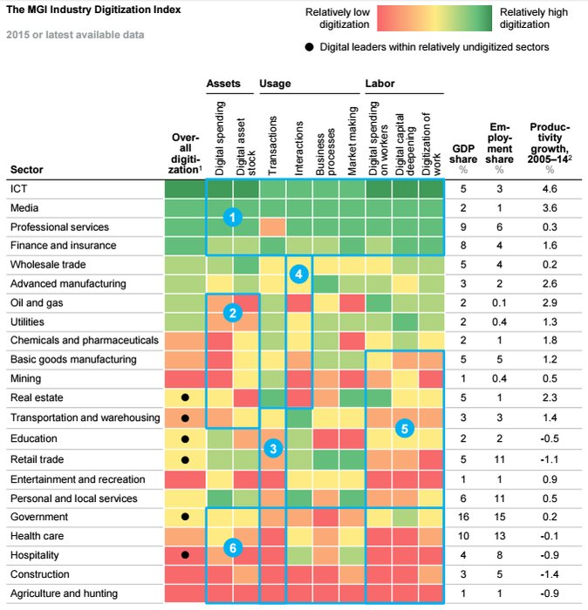
Engineering is not digital yet
CB Insights
https://twitter.com/CBinsights/status/705403757916528640
3 March 2016

Slide 4
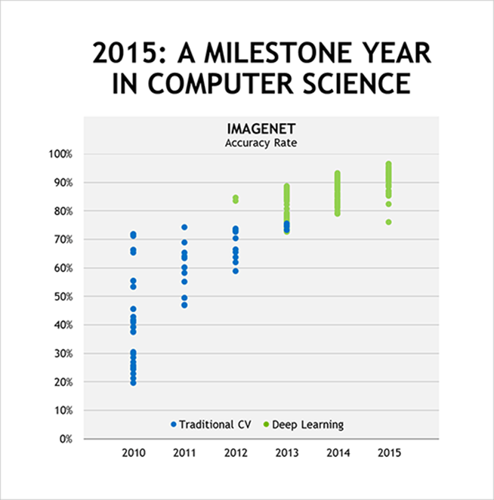
Everything will be fast
2015 – superhuman performance
2017 – last ImageNet competition
By 2011 AI researchers around the world had discovered NVIDIA GPUs.
2012 – first victory of ImageNet competition
http://blogs.nvidia.com/blog/2016/01/12/accelerating-ai-artificial-intelligence-gpus/

Slide 5
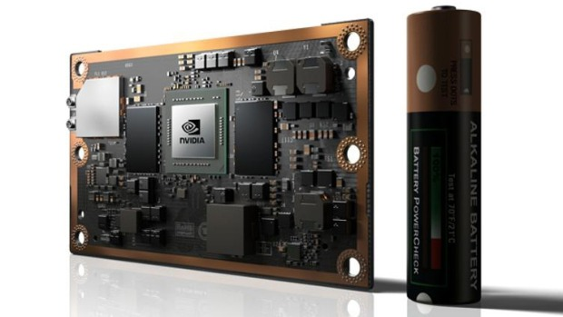
Exponential: about twice cheaper yearly
(Moore law today: GPU, not CPU) delivering with software
AI will be is a commodity
NVIDIA Jetson TX-2 – 7.5Watt, 1TFLOPS supercomputer, 50*87mm
http://www.nvidia.com/object/embedded-systems-dev-kits-modules.html

Slide 6
Intelligence Platform Stack
Disruption demand
Cognitive Architecture Platform
Application (domain) Platform
engineering
Learning Algorithm Platform
Computational library
General Computer Language
GPU/ TPU/DPU/FPGA/Physical computation Drivers
GPU/ TPU/DPU/FPGA/Physical computation Devices
CPU
Neurocompiler
Neuromorphic driver
Neuromorphic chip
Disruption enablers
COMMODITY
Thanks for computer gamers for their disruption demand
to give us disruption enabler such as GPU!

Slide 7



Change of the Life Cycle Models
whatchmaker
gardener
forester
Planning and designing in engineering
Growing and learning in engineering

Slide 8

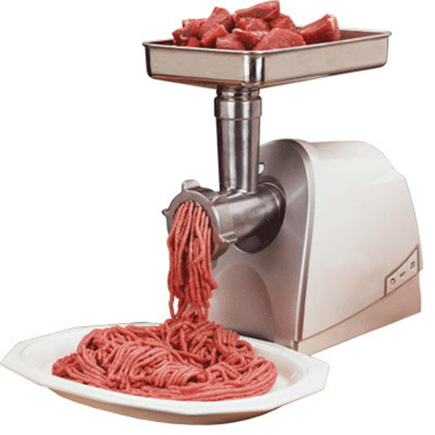

Different kinds of engineering merging and disruprtion
Machine Learning Engineering
+
Software Engineering
Control Engineering
Systems Engineering
???

Slide 9
Future of engineering
Extremal
  Multi-scale
  Multi-disciplinary
  Starts before traditional life cycle
  Ends after traditional life cycle
  More First-in-a-Kind systems
  Reverse engineering (including for verification/compliance purposes)
  Using system (not only system of interest) re-engineering
Less people, more computers (automatization)
  Generation (beyond model-based systems engineering)
  Learning, not programming
  Avatarization of software – Alexa/Siri/Cortana engineering skills
  Virtual reality for industrial design purposes
  Software as a service, clouds + edge computing (CAD/PLM in a system for resilience)
Multiagent engineering
  Cyborg-2 (agents: people and machines)
  Disintermediation of engineers (no needs for companies)
  Open engineering (open architecture first of all)
  Advanced modularity (accumulation of knowledge)
All life cycle stages (system definition AND realization AND operation)

Slide 10
Innovator’s Dilemma: its true for engineering too
(Clayton Christensen from Harvard University)
characteristics
The best products on the market
Best technologies
Disruption technologies
The worst products on the market
time
http://web.mit.edu/6.933/www/Fall2000/teradyne/clay.html

Slide 11
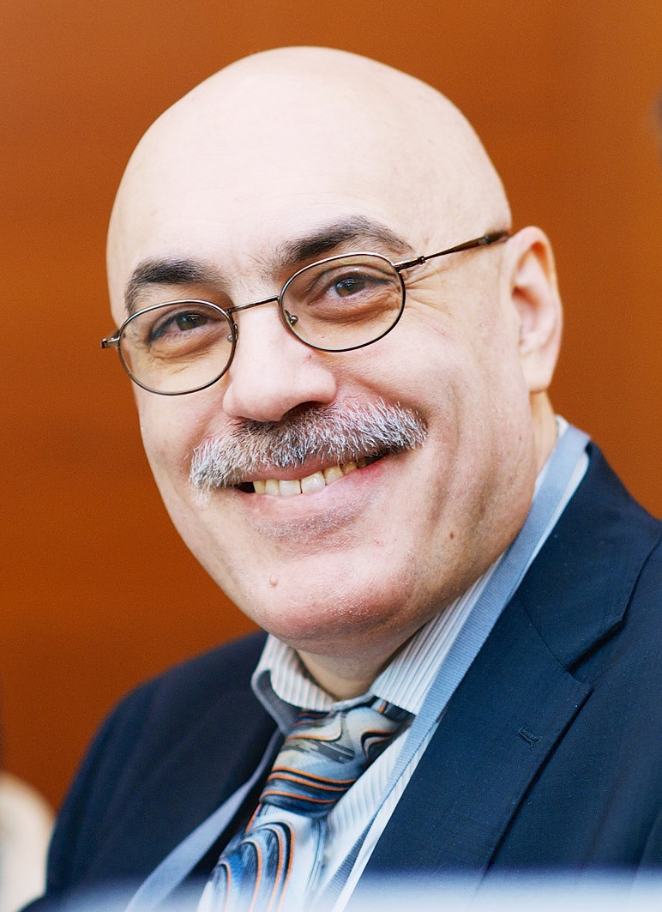
Спасибо за внимание
20 June
2017
Anatoly Levenchuk,
http://ailev.ru
ailev@asmp.msk.su

