Slide 1


On the way to Industry 4.0
and the "Smart IoT":
Multi-agent technologies to improve the effectiveness of Resource Management in Real Time
Russia, Moscow, ATOMEXPO - 20 June 2017
kg.ru
Sergey Antipin, Knowledge Genesis

Slide 2
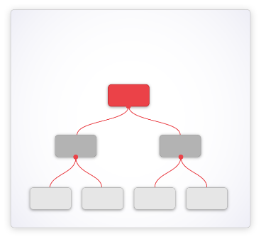
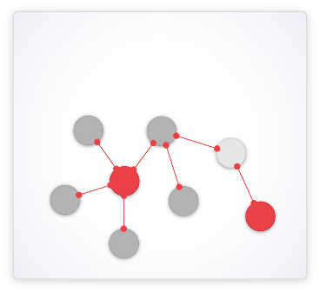
Multi-agent Technology
Traditional Systems
Multi-agent Systems
Hierarchies of large software products;
Sequential Processing;
Top-down instructions;
Centralized decisions;
Data-driven;
Predictability;
Stability;
Aim to reduce complexity;
Full control.
Large networks of small agents;
Parallel Processing;
Negotiations and Trade-Offs;
Distributed decisions;
Knowledge-driven;
Self-organization;
Evolution;
Thrive with Complexity;
Managing growth.

Slide 3
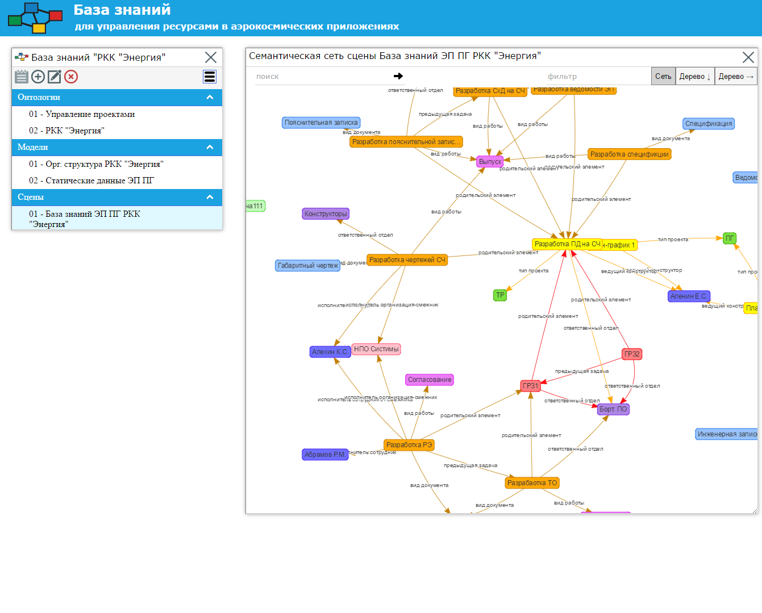
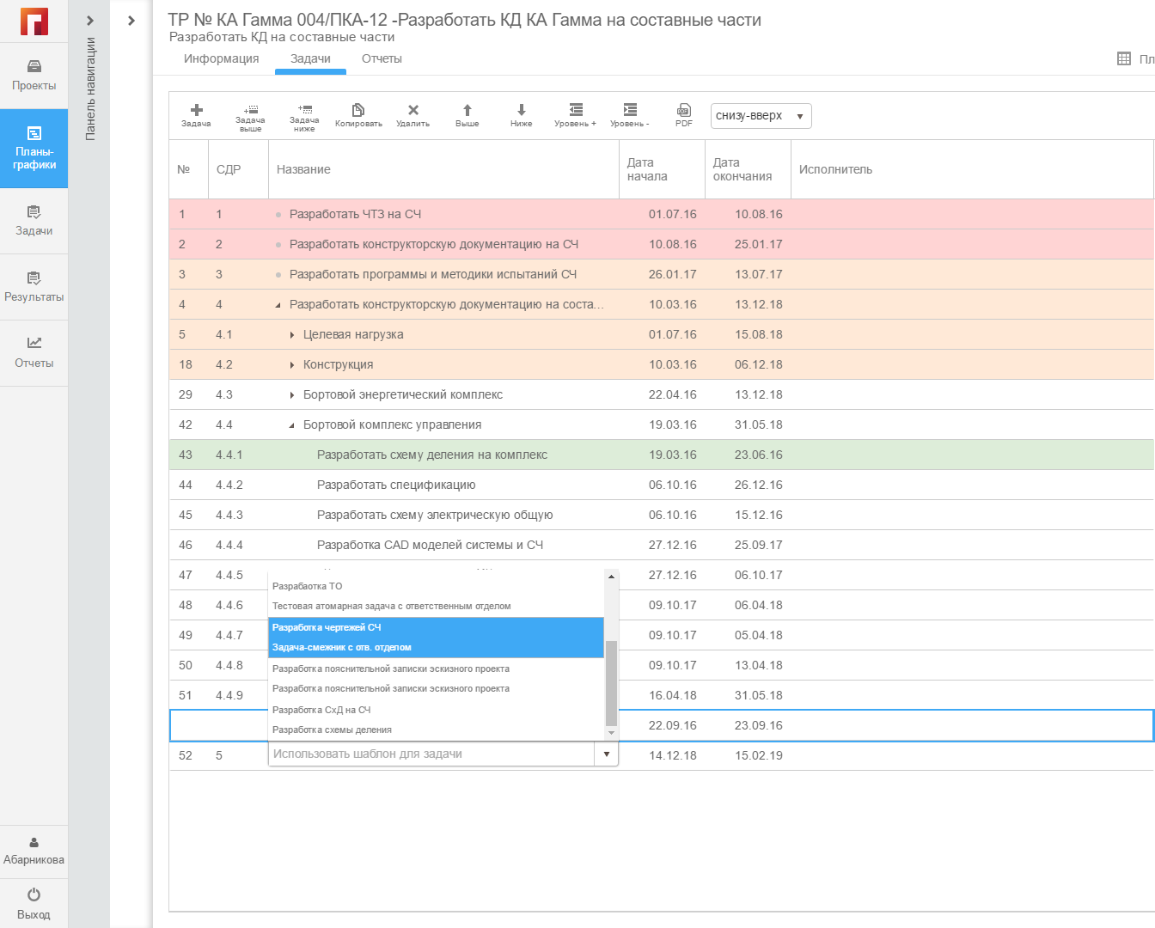
Using knowledge base
Ontology semantic project template
Created Project Plan
Based on the ontological templates, the structure of the project tasks with requirements and work amount estimations are generated automatically

Slide 4
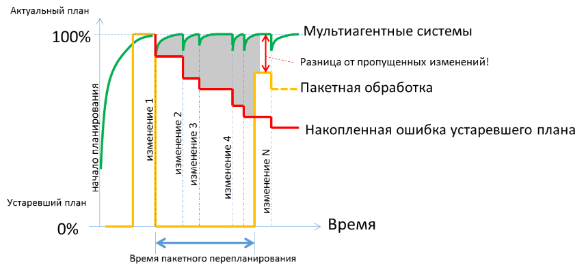
Batch VS Real Time Resource Management
Actual Plan
Multi-Agent Systems for Adaptive Scheduling
Difference between Batch and Real Time
Regular Batch Planning
Accumulated Mistake
Event 1
Event 1
Beginning of Scheduling
Event 2
Event 3
Event 4
Event 5
Event N
Old Plan
Time
Time for Batch Scheduling

Slide 5
Results of first delivery and testing in Rocket and Space Corporation “Energia”
increase of the employees work efficiency - by 10-15%;
reduction of the efforts on tasks allocation, scheduling, coordination and monitoring for running project - by 3-4 times;
increase of the reusability of the existing resources (documents, components, etc.) - from 50% and more;
reduction of the time of response to unexpected events - by 2-3 times;
increase of the percentage of the enterprise projects completed within the required budget and timeframe - by 15-30%;
the platform for increasing the number of projects without increasing the number of developers and analysts.

Slide 6
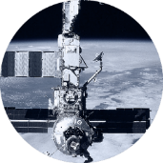
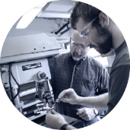


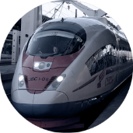
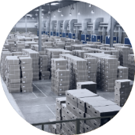
Multi-Agent Applications for Real Time Resource Allocation, Scheduling, Optimization and Control
Software Engineering Company “Smart Solutions” - 2010 (Samara, Russia)
One of most innovative and fast growing new tech companies in Russia by AIRR, RVK and PriceWaterhouseCoopers
120 employees, average age – 28
Increase efficiency of resources - up to 40%
Focus on Smart systems for real time resource management based on multi-agent technology
Smart Aerospace (International Space Station)
Smart Factories (incl Airbus and EADS projects)
Smart Transport (LTL & FTL Cargo)
Smart Mobile services
(Gas, Water, Electricity, etc)
Smart Railways (Real Time & Strategic)
Smart Supply chains (Lego, Coca Cola)

Slide 7
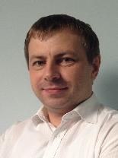
Enjoy the beauty of self-organized systems for solving complex problems
Thank you!
Sergey Antipin
Software Engineering Group of Companies “Knowledge Genesis”
Mob. +7 (910) 406 20 02
Office +7 (846) 279 37 79
E-mail: antipin@kg.ru

