Slide 1
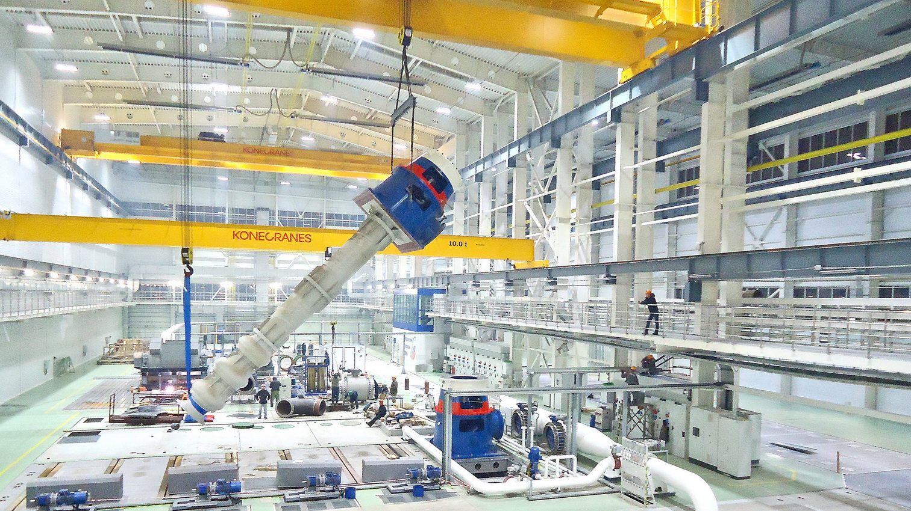
Development of
Digital Manufacturing
Pavel Bilenko
Head of the Unit for Development
of Educational Programs
of Moscow School of Management SKOLKOVO
pavel_bilenko@skolkovo.ru
June 20, 2017

Slide 2
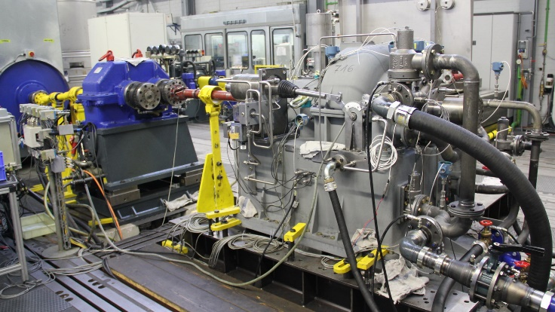
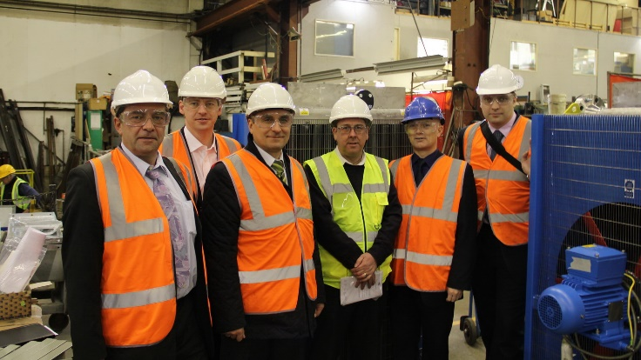
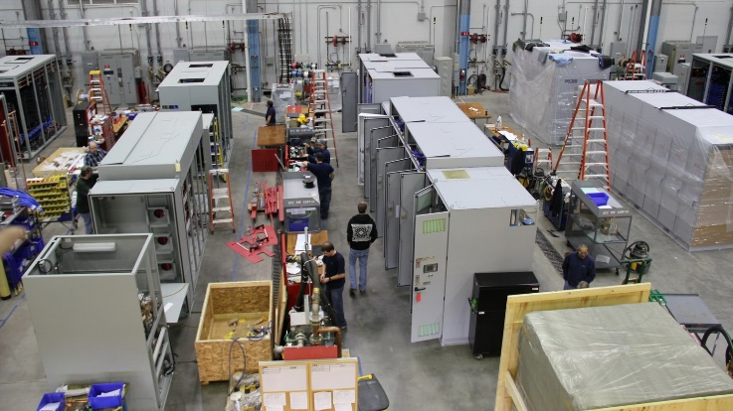
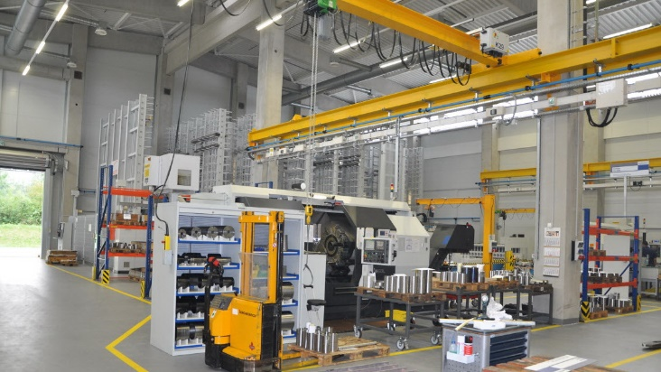
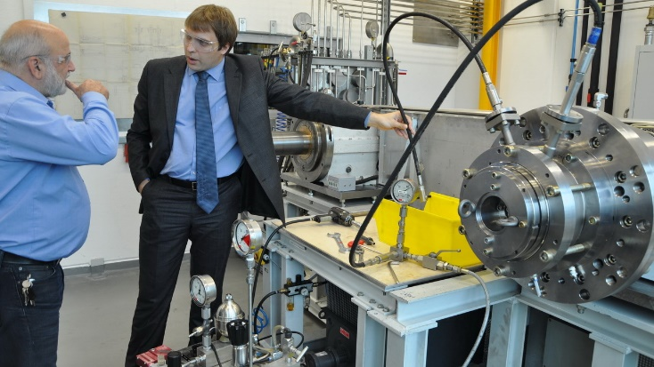
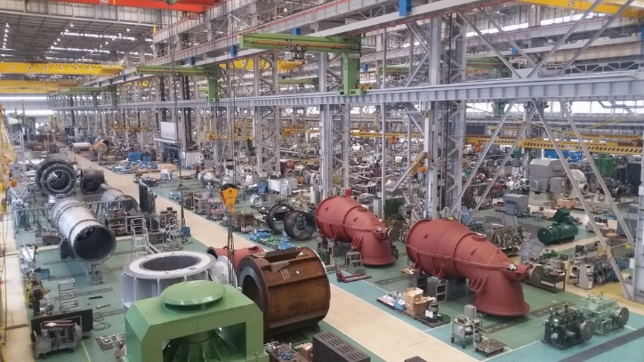
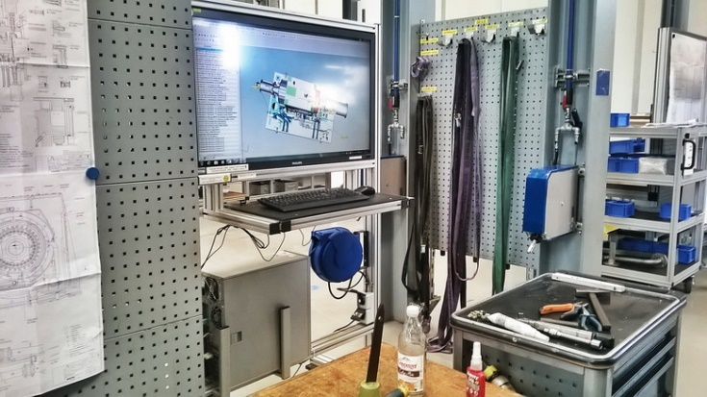
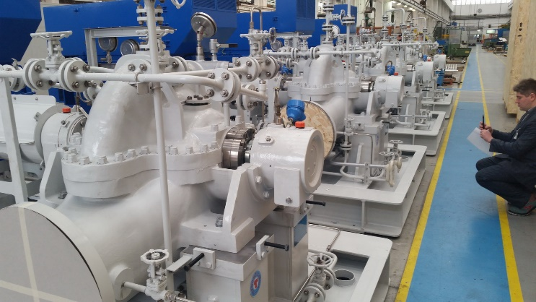
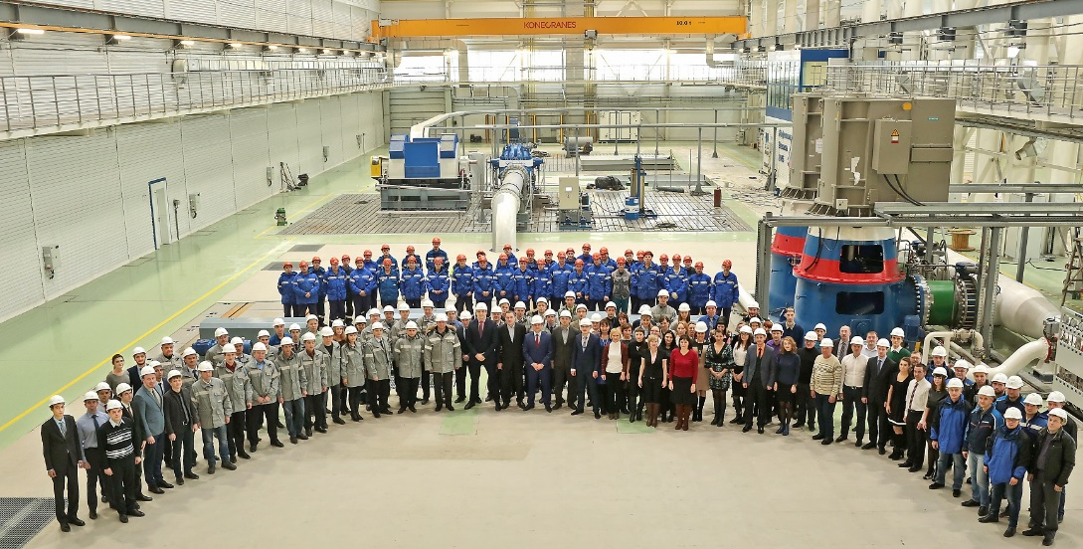
10 Years of the Team Development in Conjunction with the Leaders of Industry 4.0
Germany VOITH 08.11.10
England SHE 07.12.10
USA Siemens 05.04.11
Germany IB 10.12.12
Germany IB 28.08.13
Japan Ebara 20.01.15
Germany VOITH 19.02.15
Italy TMP 03.03.15
Chelyabinsk TOP 08.12.15
Notes:
At each factory, we with the team first and foremost paid attention to the work of design and technological services, the engineering training and the most important – the systems of automation of all the business processes of the enterprise – PLM and ERP systems. At Termomeccanica in Italy, we organized our office for the purposes of technology transfer.
Secondly, we looked at the operational aspects of the manufacturing system. We saw the traceability of raw and other materials and the work of MES and ERP.
Thirdly, we invited these companies to develop in Russia in the format of joint ventures or subsidiaries.

Slide 3
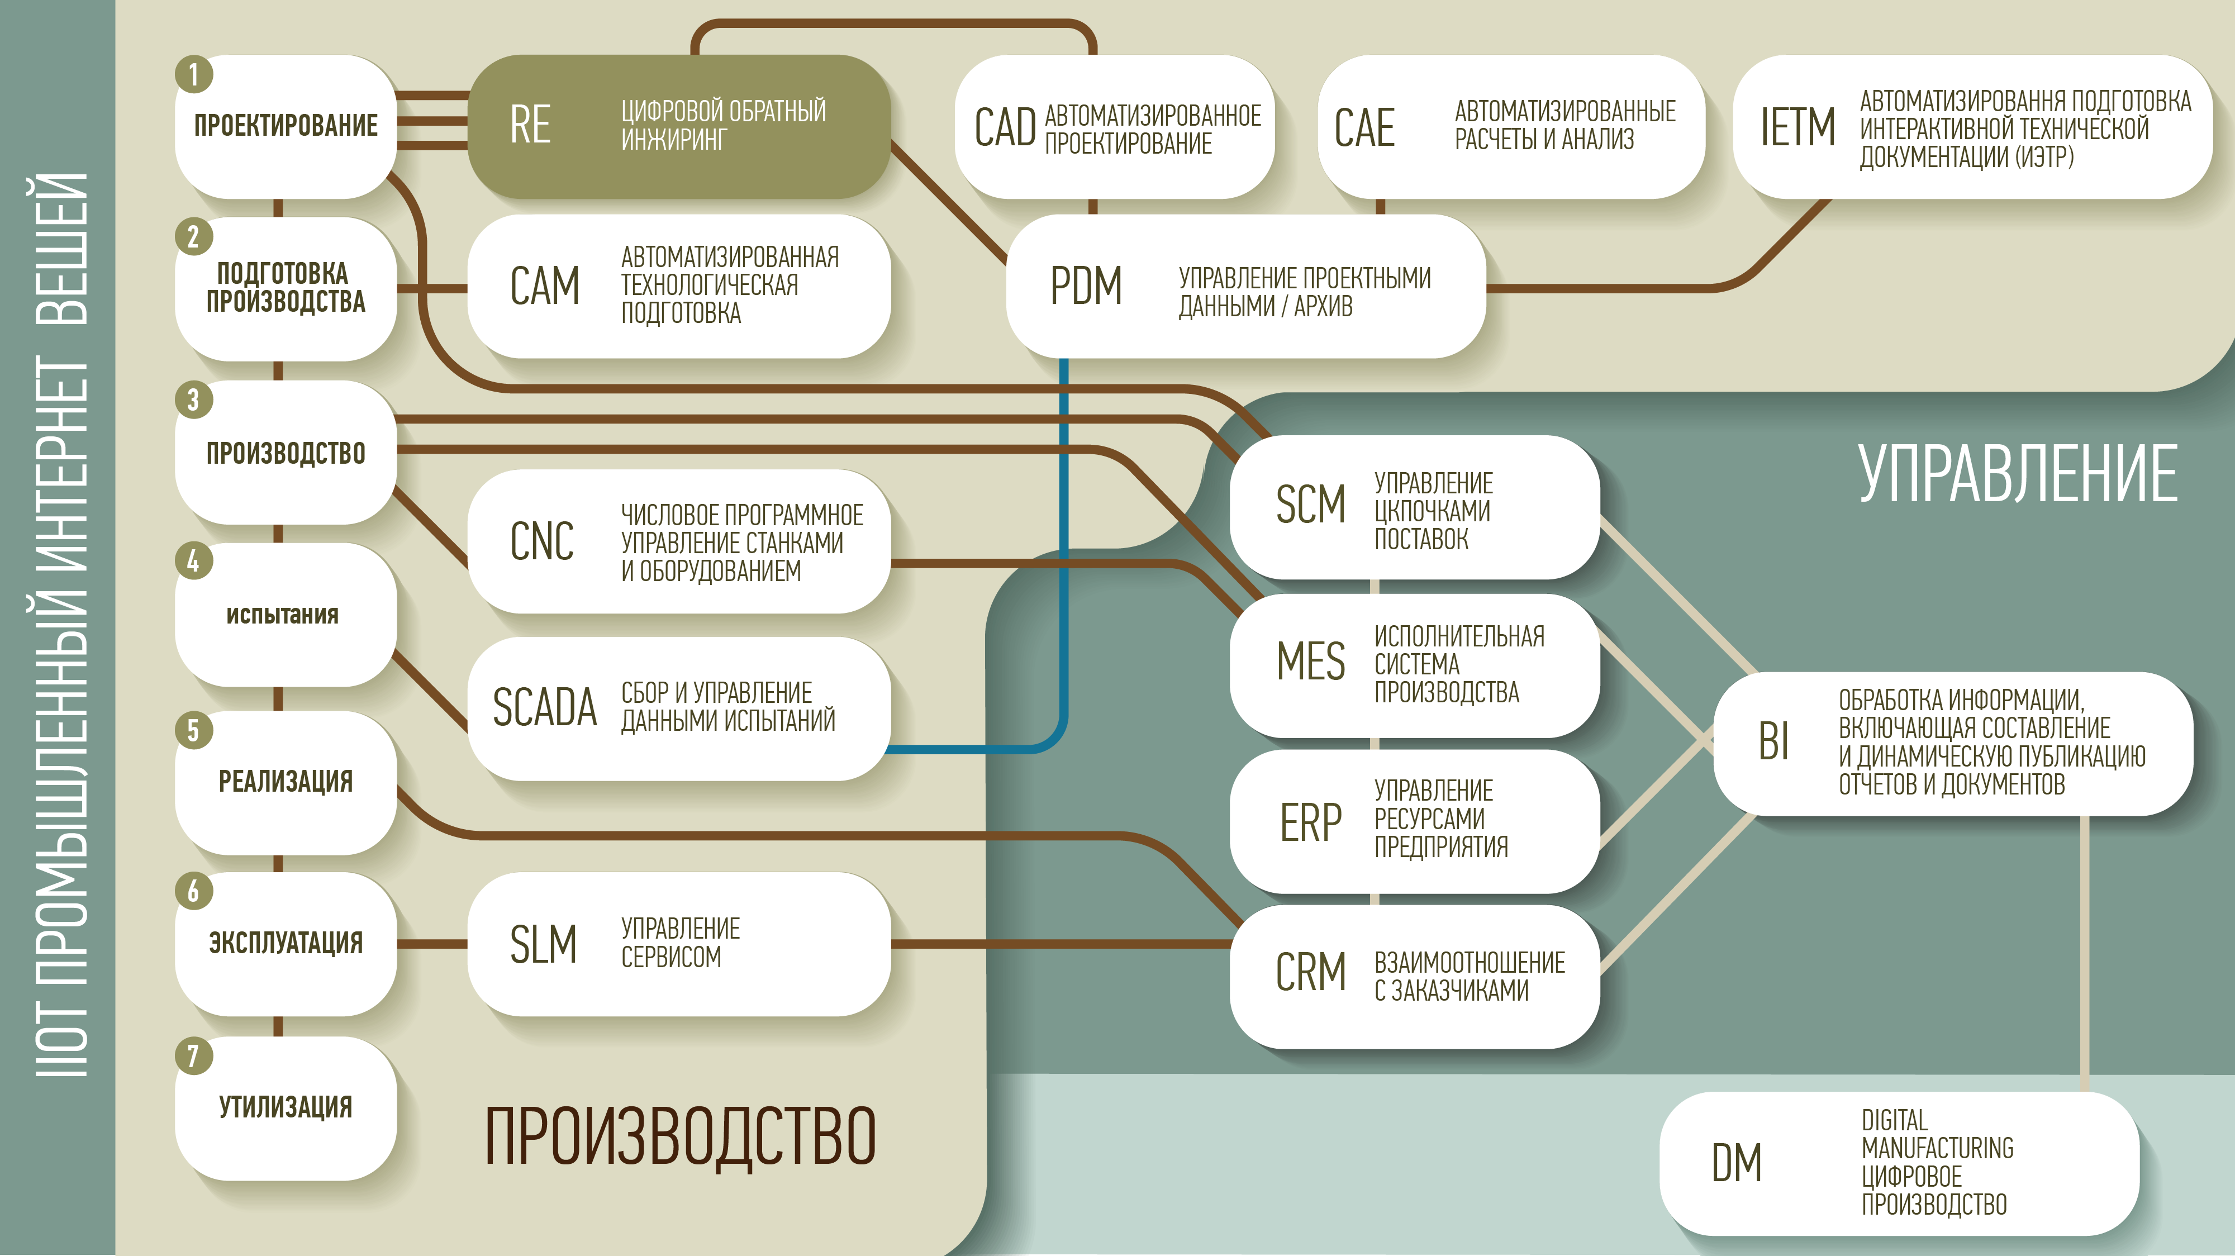

Slide 4
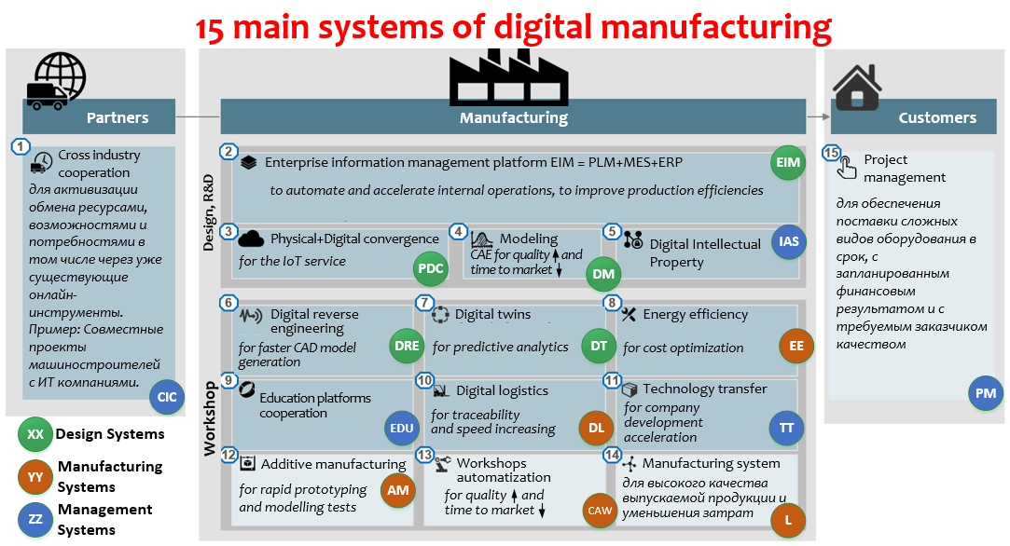
What experience did we adopt? 15 management systems
© Pavel Bilenko 2017
Notes:
At each factory, we with the team first and foremost paid attention to the work of design and technological services, the engineering training and the most important – the systems of automation of all the business processes of the enterprise – PLM and ERP systems. At Termomeccanica in Italy, we organized our office for the purposes of technology transfer.
Secondly, we looked at the operational aspects of the manufacturing system. We saw the traceability of raw and other materials and the work of MES and ERP.
Thirdly, we invited these companies to develop in Russia in the format of joint ventures or subsidiaries.

Slide 5
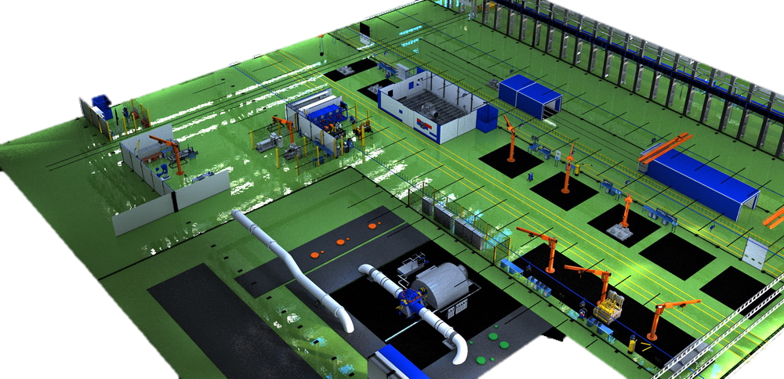
Digital technologies of Industry 4.0 of manufacturing company today
Digital reverse engineering:
on a full scale
Simulation:
CFD and digital counterparts of equipment
Augmented reality: approached via automated workstations
Operator's room in the center of the shop to control the cyber-physical manufacturing platform
Additive manufacturing: simulation tests of pump wet ends
Big Data and analytics: predictive analytics, manufacturing system's data management in PLM and ERP

Slide 6
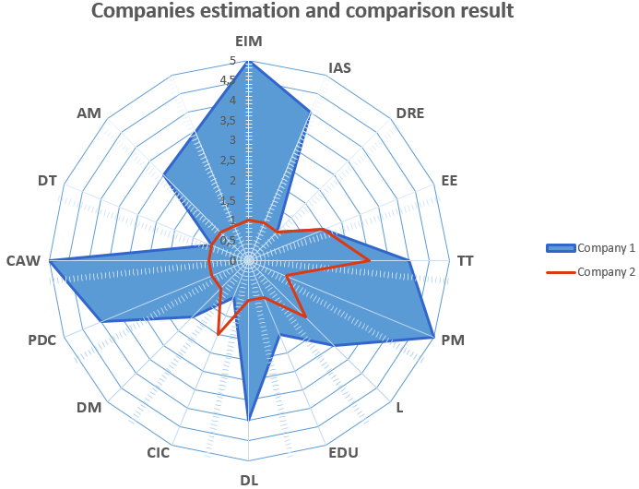
Benchmarking of the companies digital maturity
© Pavel Bilenko 2017

Slide 7
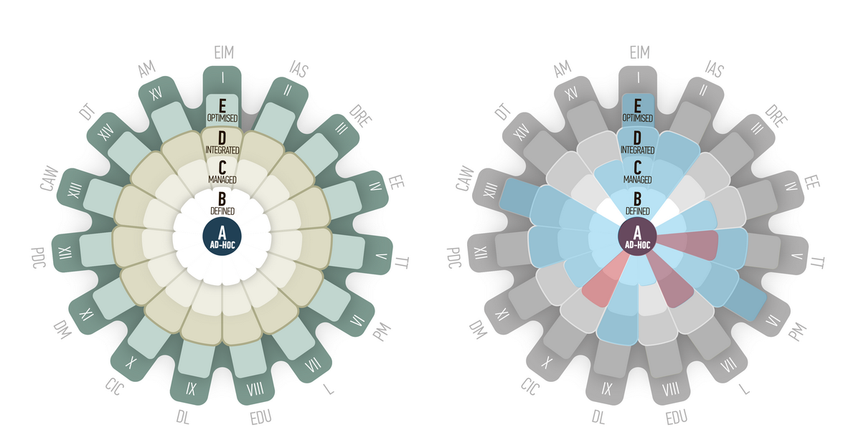
Evaluation of Digital Maturity:
Where we are and in what direction to develop?
© Pavel Bilenko 2017
Notes:
Why is it important?

Slide 8
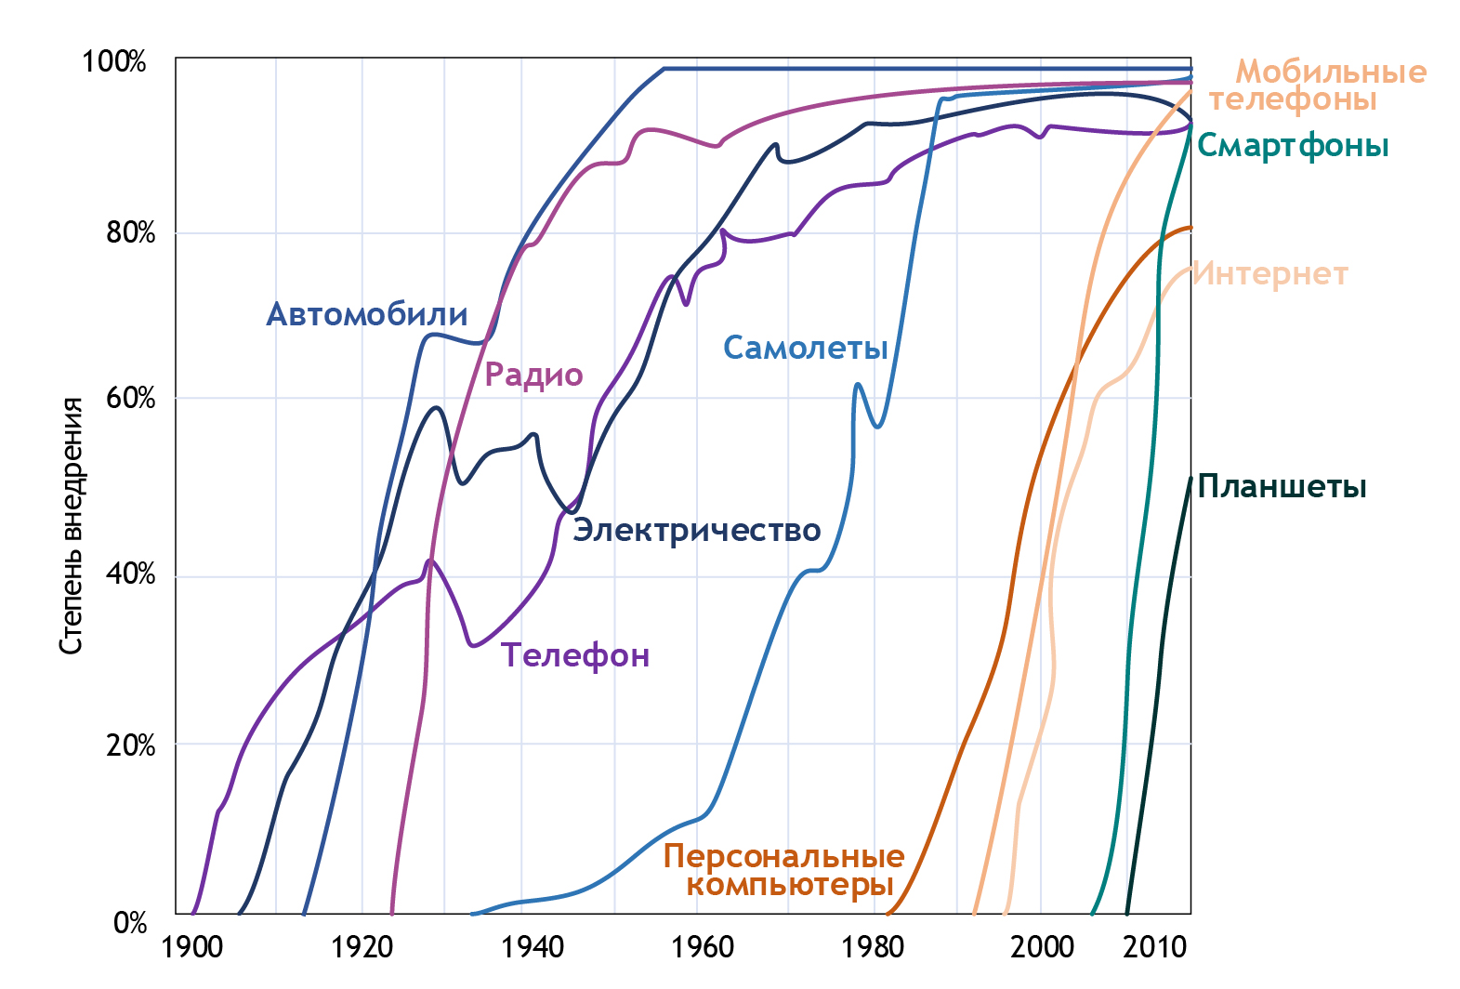
Mobile phones
Diffusion
of consumer's
technologies
Smartphones
Internet
Cars
Planes
Radio
Tablets
Electricity
Phones
Personal computers

Slide 9
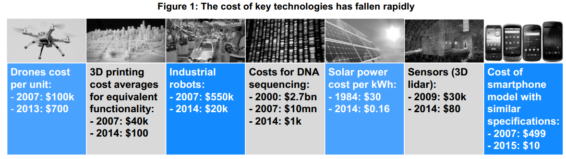
Why Did It Happen?
2010
2014
World Economic Forum White paper digital transformation of industries: Digital Enterprise, January-2016
2015
2016
Notes:
20% faster assembly, higher quality, less expensive

Slide 10
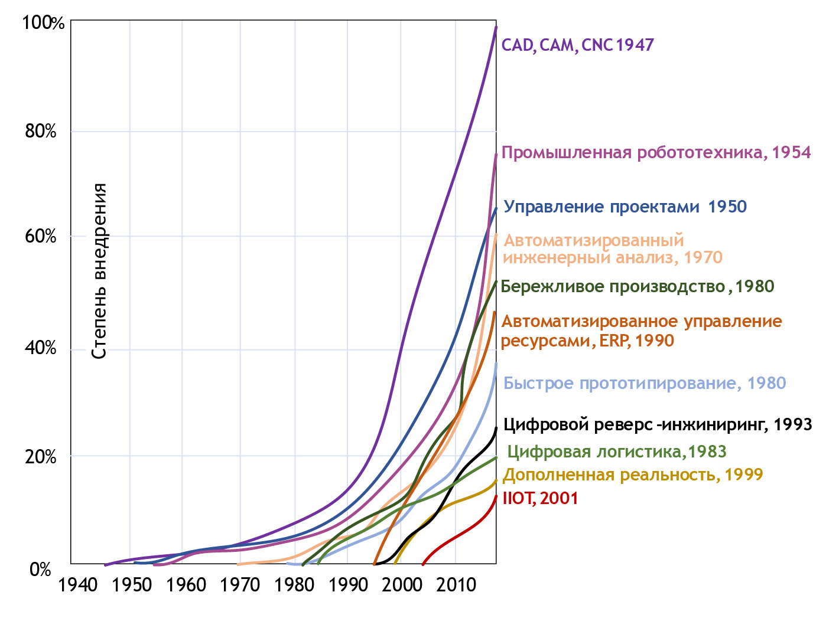
Acceleration
of J-technologies
diffusion
CAD, CAM, 1947
Industrial robots, 1954
Project Management, 1950
CAE, 1970
Lean, 1980
ERP, 1990
Rapid Prototyping, 1980
Digital Reverse Engineering, 1993
Industrial AR, 1999
IIoT, 2001
Notes:
What does it mean for us? I propose you to answer this question all by yourselves

Slide 11
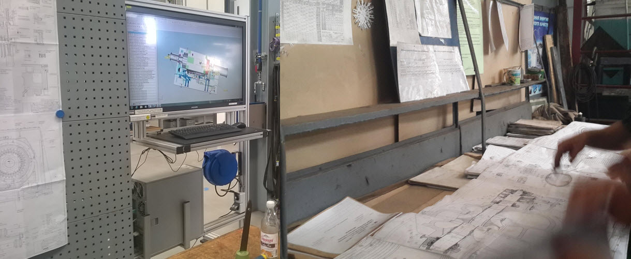
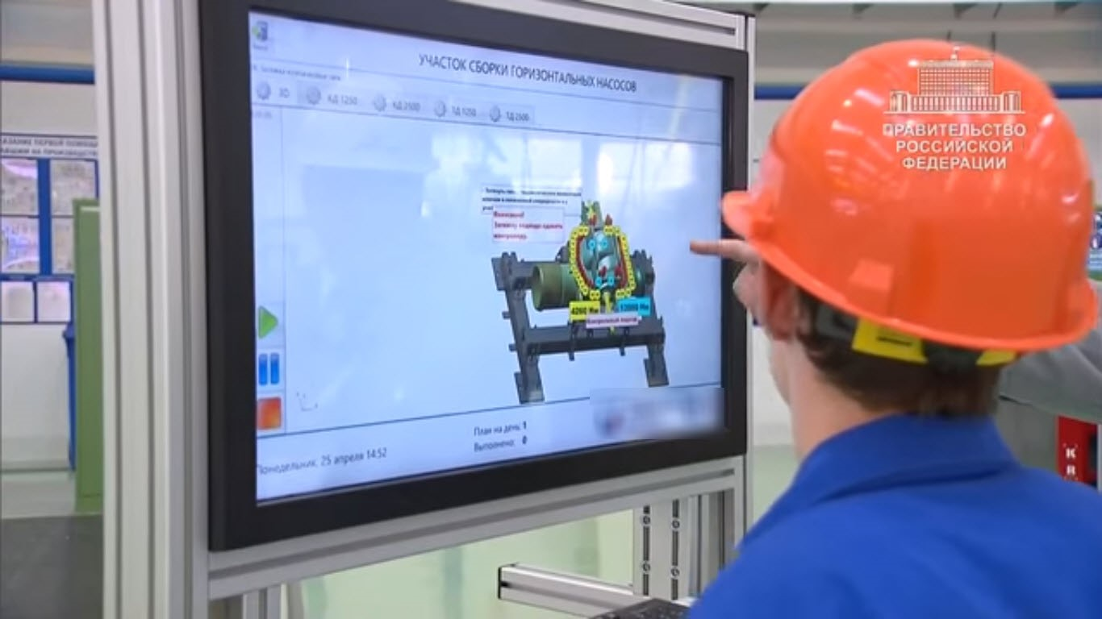
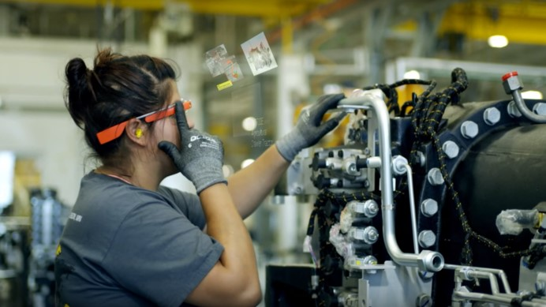
Evolution of a workshops automatization
2010
2014
2015
2016
Notes:
20% faster assembly, higher quality, less expensive

Slide 12
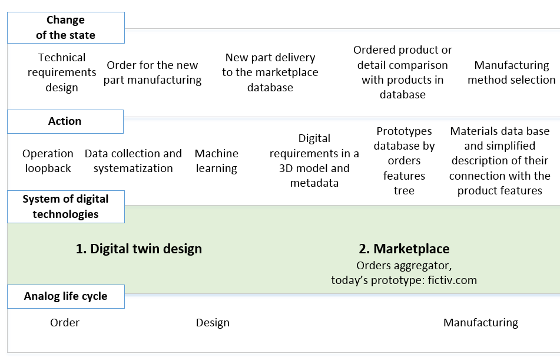
Next generation product lifecycle management:
autonomous manufacturing, part 1
part 2 →
© Pavel Bilenko 2017

Slide 13
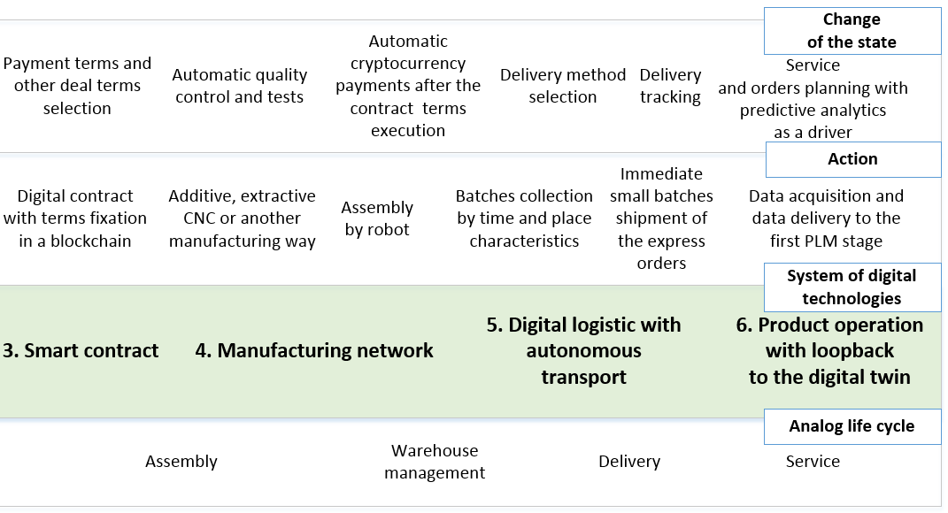
Next generation product lifecycle management:
autonomous manufacturing, part 2
© Pavel Bilenko 2017

Slide 14
RESUME
1. Today the system-based effective use of key systems and technologies determines the time-to-market, performance, quality, and cost of production.
2. Our barriers are disintegration and complexity of communications between market participants or lack of non-profit institutes for development.
3. For working with barriers, in the first place, we should not be afraid to really evaluate the place of our company among the leaders and average industry values, put aside the technological arrogance and learn.
4. The evaluation and design of the development pathway of the company and industry is the most effective through communications on a cross-industrial platform.
5. The results of such communications, in addition to the projected pathway, are the guiding industry documents on each of the directions of development of a new technological mode and the development of company's management teams in the educational programs.

Slide 15
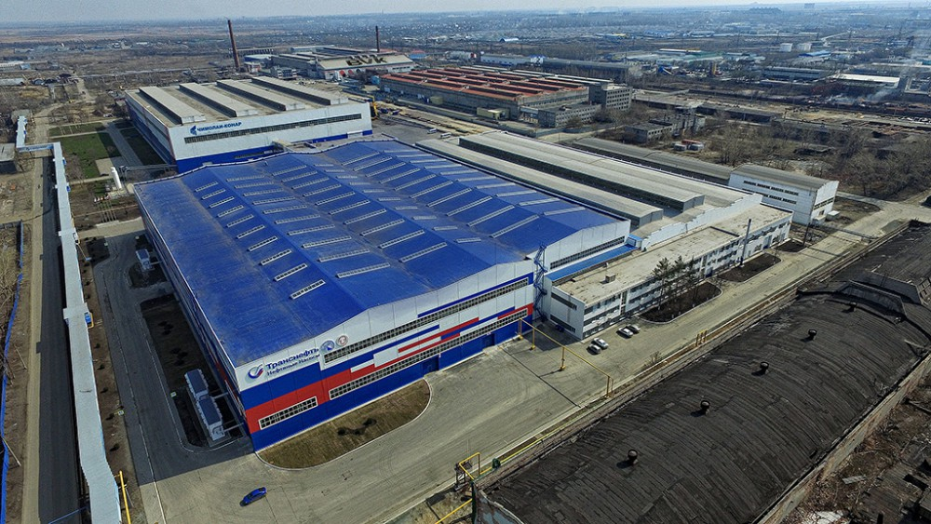
Development of
DIGITAL MANUFACTURING
Head of the Unit for Development
of Educational Programs
of Moscow School of Management SKOLKOVO
pavel_bilenko@skolkovo.ru
Pavel Bilenko
June 20, 2017

