Slide 1
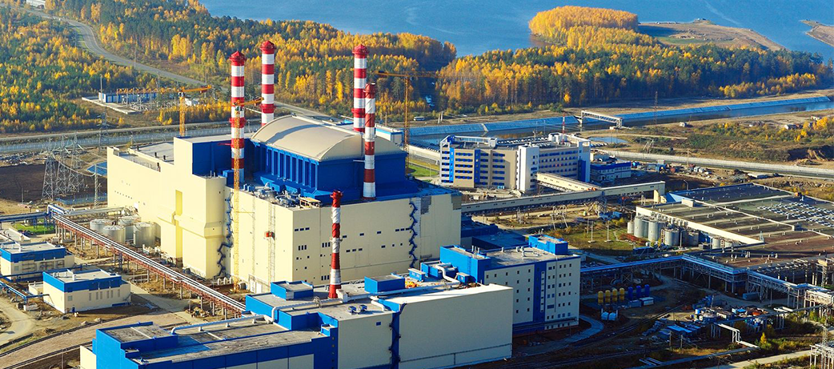
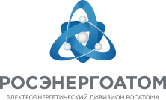
Rosenergoatom Digital Transformation
Oleg Shalnov
Moscow | 19-20 June 2017

Slide 2
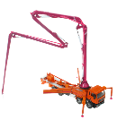

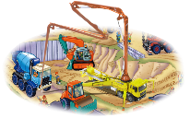



Digital company from a stand-alone automated processes to a unified information field and integrated landscape
Construction Processes Management
Operation and MRO
Material Management
Financial Budgeting
Treasury
Management Accounting
Human Resource Management
Customer Relationship Management
Business and Tax Accounting
Electronic Document Flow
Evaluation and control of volumes and resource management
Operational Data (Consolidation)
Data on partners (multianalyst and dossier),
Life Cycles Documents Transfer
Facilities/Assets Data Modeling (forecast of state)
New Services Based on the Internet of Things (model of operation)
Contextual and Intelligent Search of Online Documents and Unstructured Data
2018
2017
Management
Asset
Contractors
2018
Business Analytics
Forecasting
2017
Custom
ERP Task
24/7
BIGDATA
2017
Business Processes
“If the rate of change on the outside exceeds the rate of change on the inside, the end is near”
Jack Welch, GE
Efficient operation of a modern NUCLEAR POWER PLANT without a digital model: “Electric Power Unit - Service Facilities-Processes-Resources-Shedules-Relationships-Experiences-Best Practices-Documentation-Information Field-Social Space” is impossible

Slide 3
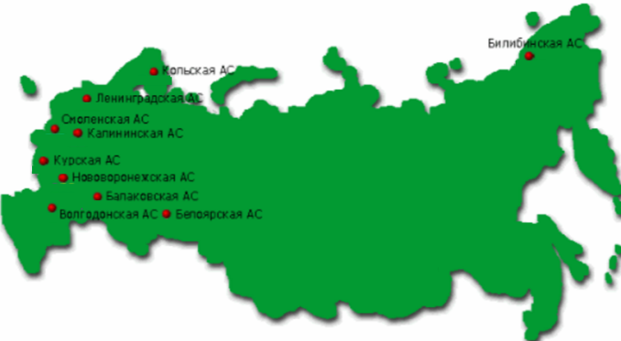
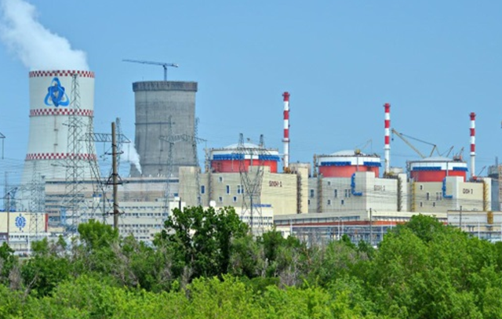


SAP 2015-2017 implementation and replication in Rosenergoatom is the basis of an electronic centralized resource management
37 thousand employees in Rosenergoatom
 | KEY RESULTS: Unified Generic Solution for the Central Office, 10 Nuclear Power Plants and other Branches, 4,500 users. Two “waves” for 18 months. APPLICATIONS: SAP ERP (+BI, BPC, HCM, MDM) KEY BUSINESS PROCESSES: Material and Contracts Management, including: a centralized approach to procurement and branches financing; capital construction processes supporting; Investments and Projects Management, including: investment projects and activities structure unification; maintaining performance limits for projects/activities; financial sources control and management; integration with the local facilities construction monitoring system Financial Management; Cost Management, including: cost accounting by function; Business and Tax Accounting; FA, PE, PPE Accounting; Sales Management; Human Resources Management, including: staff development; integration with adjacent corporate systems of SC Rosatom and divisional IS
West - the city of Kaliningrad
East - the city of Bilibino, Chukotka, 7,000 km
40% of employees actively use SAP solutions in daily work
The coefficient of ERP-system using is 93%
9,000 users of human resources management system SAP HCM+
(IHRMS + qualification Rosenergoatom add-on, integration)
 | PRODUCTIVE STARTUP: January 01, 2016 – 6 business units (CO, NPPs and branches) January 01, 2017 – 10 business units (NPPs and branches) Without parallel accounting in historical systems Experimental operation period 4 months (The first quarter is closed on the 7th WD of April, regular operation) Since May 19, 2017 - industrial operation
10 NPPs
All through the country for 18 months

Slide 4


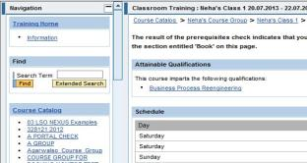
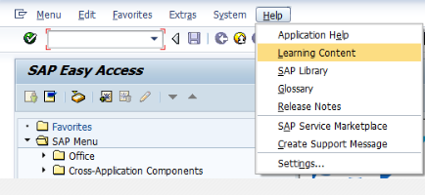
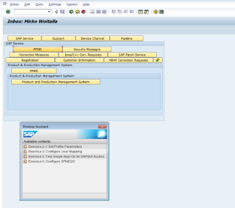

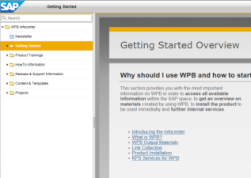


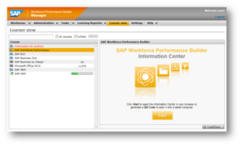

SAP ERP unified fully functional centralized resource management system in industrial operation in Rosenergoatom since May 2017
Hierarchy of centralized programs and projects management (investments, development projects), a full project accounting scheme
Planning and accounting by programs/projects/activities/articles/sources of funding
A unified approach to the classification of costs and the CostCntr/ NPPs’ Cost Center structure
Flexible reporting on sources of financing with limit control, reporting on the investment program and project programs
Corporate contracts (unified procurement of NPP with automatic delivery diversity, limit management)
Expenses for processes and functions ("benchmarks" of NPPs) - parallel cost accounting
1
2

Slide 5




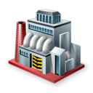
ERP project business objectives
We achieved (2017):
    Reduce of resources for
    2 years - more than10%
    Production costs reduction - more than - 2 billion rubles in 2016
    Centralized processing of requests and purchase orders, minimum 2 times faster in terms of time (stabilization)
    Decrease the number of
    FEBs of the Moscow region by 18% in 2016, liquidation of “unnecessary” branches of the Concern (centralization)
We planned (2015):
    Reducing the cost of keeping resources no less than 5%
    Production costs reduction by 20-25% for three years (~ 10 billion)
    Reducing the cost of processing requests and purchase orders - 20% (in number), 4 times faster in terms of time
    Reducing the cost of maintaining existing information systems) by at least 10%
    Reducing the average number of financial and economic and auxiliary units by at least 20%
Order in business analytics

Slide 6
SAP HCM unified fully functional centralized human resources management system
A unified approach to personnel administration, management of organizational and staff structure(OSS).
Unified methodology of staff work time logging, calculation of wages, accruals and deductions, reports compilation.
Unified management of the personnel reserve: recruitment, performance evaluation, staff motivation
Clearances to work unsupervised
“Virtual" competence assessment certificate, briefings on labor protection, electrical safety, fire safety, certification, personnel certification in Rostekhnadzor.
Unified social policy.
Housing programs NPP personnel health care· Social support for pensioners
Technical Academy automation.
Staff training management. Professional training in Russia and abroad.
1
2

Slide 7
Operation and MRO (2017/2018), integrated with SAP ERP is the foundation for the formation of the basis for the further development of the product offer on the basis of “Big data" (Operational experience recording)
1. Pilot project: development of MRO platform (2017/2018)
2. Further product offer development
Status monitoring and facility maintenance:
status assessment:
technological parameters collection
failures and defects statistics
status modeling
Crisis Management Centre and response management
Unstructured data intelligent search, events/parameters correlation, operational experience
Exploitation processes support and safety ensuring (+ inspection processes):
EAM
document management, event registration
event logs
quality records
Knowledge management and e-learning (interactive technologies and automatic courses parameterization)
An integrated solution to ensure cybersecurity
Repair program planning, ERP MRO:
material and labour resources
dosimetric limits
readiness assessment
requirement management
Project management, an information field solution, mobile platforms and modular data centres, dashbord components rent, customer’s portal
Modular data centers built into the NPP power utilities, data center IT services

Slide 8
Operational experience recording
Special comprehensive OERAIS
Rosenergoatom related IS
Statistical analysis and forecasting
Comparison of the equipment operational modes and equipment events
Probabilistic analysis and systems and equipment events forecasting
“Disposed experience”- operational experience statistical reporting in relation to the type of equipment
(QlikView + …)
MRO ACS
Information on plant inspections and equipment repair/maintenance, etc.
(IBM Maximo)
Search and analysis
Connection to ADECS
Recurring events search
Corrective measures effectiveness analysis
Thematic analysis (nuclear safety, nuclear fuel reliability, chemical safety, etc.)
Current project
Consolidating data from CO sources (violations, deviations, defects, VMS, etc. 10 sources altogether) with scan recognition function
Unified search across all sources (like Google search)
Filters, infographics, reports on topical areas (8 areas by role)
Events identification correlation, search for similar ones
(HP Autonomy IDOL)
Business Processes Automation
Recording and investigation of violations in NPP operation
Recording and investigation of deviations in NPP operation
Recording and investigation of significant defects
Corrective and preventive actions implementation supervising
Good practices recording and disseminating
VMS recording and analysis
Reporting (including Production control)
(IBM Maximo)
ISCOPPM
Information on the equipment operational modes
(OSISoft PI)
TDACS
Technical documentation (legislative, executive, operational documentation, etc.)
(EMC Documentum)

Slide 9
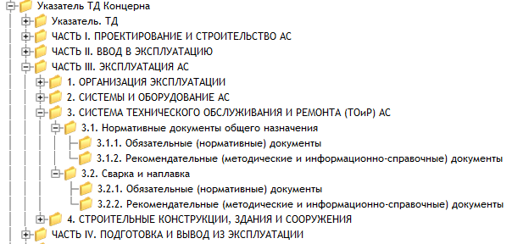
Unified platform for managing and storing technical documentation for all Rosenergoatom divisional information systems
Management and archival storage of technical documentation at all stages of NPP life cycle, including project, detail, executive, commissioning, design, production and technical, regulatory documentation, etc.
Distributed system architecture that can provide technical documentation to all divisional information systems (MRO ACS, NPP OERA, etc.), employees of the Concern, as well as to employees of contract organizations.
Application of a unified approach to the classification of NPP technical documentation, providing an effective searching for technical documentation of all Concern’s branches.
Access to technical documentation via portal and the search system for unstructured information in NPP OERAIS

Slide 10


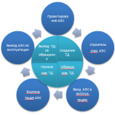
Unified platform for managing and storing technical documentation (TDACS) for all Rosenergoatom divisional information systems
The current project status for TDACS creation and development
2. TDACS development in 2017-2018.
Management and technical documentation archives:
Technical documentation formation and updating in TDACS archives (creation, adjustment, cancellation)
Archives creation for the Concern CO documentation:
  CO regulatory and methodical documentation
  CBCPI project documentation
  CBCPI report documentation based on the Concern’s contracts
  CO learning and teaching documentation
  MRO documentation generated by ARSRINPP.
Аrchives at Leningrad NPP, Balakovo NPP, Beloyarskaya NPP, Kurskaya NPP, Novovoronezh NPP:
  operational documentation
  project and detail documentation
  normative and managerial technical documentation
Creation of functional modules for storage and management of PND, factory, executive, design, information and reference and management documentation
Archive creation for management documentation, and financial and accounting reporting documentation related to the contracts
Function module creation for research and development documentation management
Information and analytical showcase creation for Concern technical documentation
Search and access to technical documentation:
search of technical documentation in TDACS by the attributive structure
contextual search
access to documentation by means of the Concern information portal
TDACS documentation intellectual search through NPP OERAIS (unstructured information search)
TDACS integration with Concern IS (SAP ERP, MPO IS, SPAND, etc.), as well as with ASE and JSC “Atomtekhenergo” information systems

Slide 11
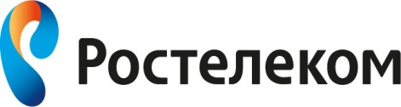
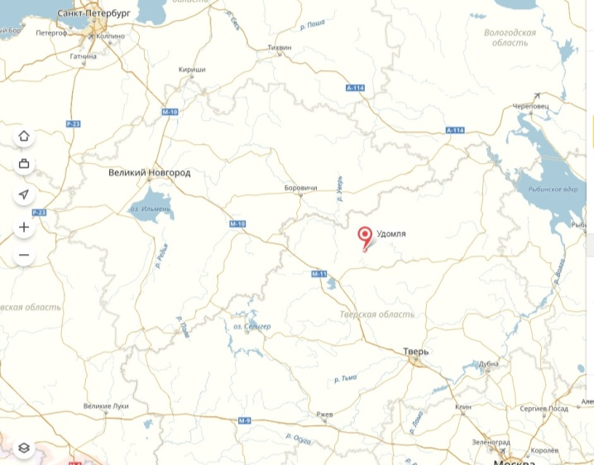
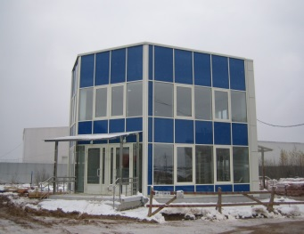
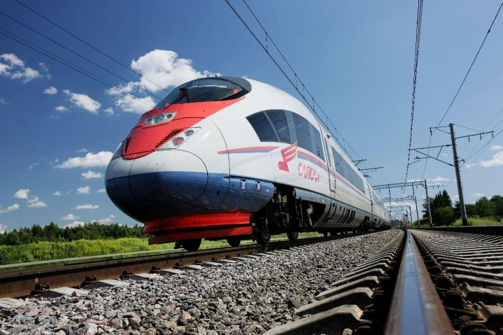
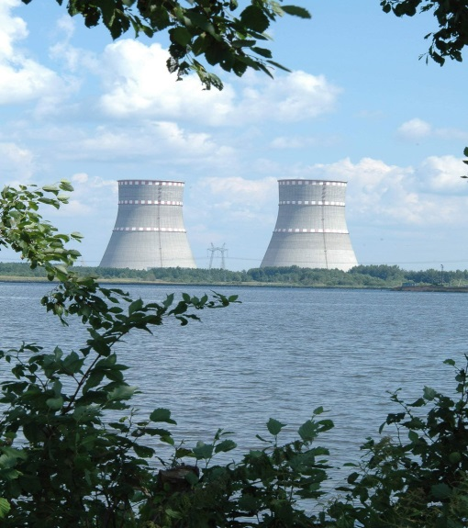
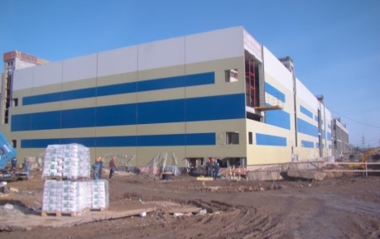
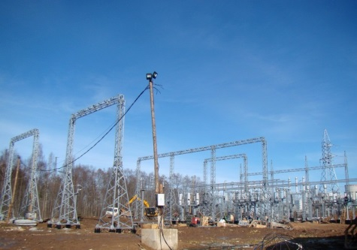
Europe's Largest Data Center - MENDELEYEV Project
Increased demand for computing resources in connection with the introduction of centralized systems:
  resource management
  construction management
  operating and maintenance
  competence center and operational experience
Data volume growth
  The annual data volume growth х 2 times
Saint Petersburg
Udomlya
from Moscow or St-Petersburg
2 hours by Sapsan train to Vyshny Volochyok station + 20 minutes by car, parking, hotel, office space
Tver
Moscow
48 Mw August 2017
Key Benefit:
direct connection to Kalinin NPP
(more information on rosenergoatom.ru)

Slide 12

What comes next? Development roadmap
Development of solutions in the field of capital construction - cost and construction schedule management (2017/2018)
Transition to the SAP HANA platform (2018/2019)
Enhanced analytical reporting (2017/2018)
Ergonomics and mobile solutions (2018/2019)
Transition to the centralized portal solutions (2018)
Legally significant electronic documentation management (2018)
MRO and operational experience management (2017/2018)
Information Security management (2017/2019)
Embedded controls management (2018/2019)

Slide 13
ANNEX
Further Reading

Slide 14

General architecture of Rosenergoatom solutions
Consolidation, analytical reporting
SAP BI
Analytics, dashboards of a manager
Rosenergoatom corporate template
Human Resource Management
SAP НСМ
Investments and Projects Management (PS)
Material Management (MM)
Sales Management (SD)
Capital Construction Management
(IVSLS, LTIPA, EPMIS)
Budget management
SAP BPC
Cost Management (CO)
Financial Management (FM)
Sales Management (SAS)
Master Data Management
SAP MDM
Maintenance, Repair, and Overhaul Management (MRO)
Rosatom corporate financial template
Integration bus
SAP PI
Accounting (FI)
Tax Accounting
(FI-SL)
Fixed Assets Accounting (FI-AA)
Concern Portal
SAP Portal
Technical Documentation Management
TDACS
Supplier Relationship Management
SAP SRM
Document Management
UISEDM, LSDM
Corporation Processing Centre ( Rosatom CPC)
Rosenergoatom Know-How

