Slide 1
ATOM EXPO 2017
Best practices of digital adoption in industrial companies (session 1.1)
Notes:
Welcome: Ladies, Gents, Friends, Colleagues and Speakers to our session entitled: …Best practices of digital adoption in industrial companies.
Thankyou to Rosatom for inviting myself and Fiatech to facilitate this session.
Main Topic of track: World economy is developing in completely different ways that a decade ago. Technology is the answer. Those who are not in the digital era are not on the train of world economy. The ambitious challenge is to become a digital corporation. In Recent Years Rosatom rapidly developed its Technological potential to ensure /enhance the competitive performance in international markets. Rosatom has a unique Multi D system of capital facilities for life cycle
Management , development and implementation of digital solutions. Taking into account the Russian Gov’t objectives on tech development Rosatom can become the driver for the country’s economic dev’t

Slide 2


ATOM EXPO 2017
Notes:
Intro to the organisation that I am involved with.

Slide 3

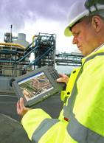
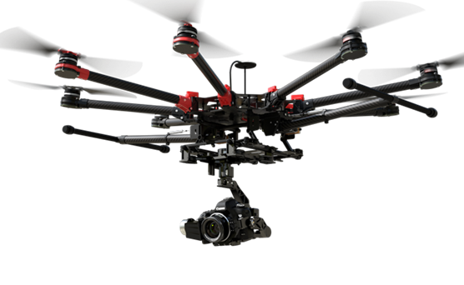
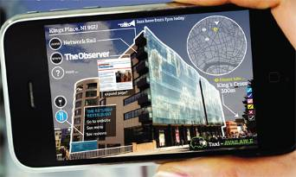
What is Fiatech and what is it’s Mission?
A community of
passionate stakeholders working together to lead global development and adoption of
innovative practices and technologies
to realize the highest business value
throughout the life cycle of capital assets.
Fiatech’s members are united by one goal:
…. step change improvement in the design, procurement, engineering, construction, and maintenance of large capital assets.
Notes:
….What is Fiatech????……International Community…..that leads the global development of technology and adoption of Innovation and practice…….. they do this through Collaboration.
Fiatech's members have one goal…step change improvement in design procurement Engineering. constr and O and M of capital facilities
“Transforming the World's Infrastructure Delivery and Operations through Innovation.”

Slide 4

Notes:
representing all segments of industry – owners, contractors, EPC’s, vendors, suppliers, academia International composition with Global Partners
Fiatech was formed in 2000 and is the result of CII members efforts to embrace Technology that was beginning to emerge.

Slide 5
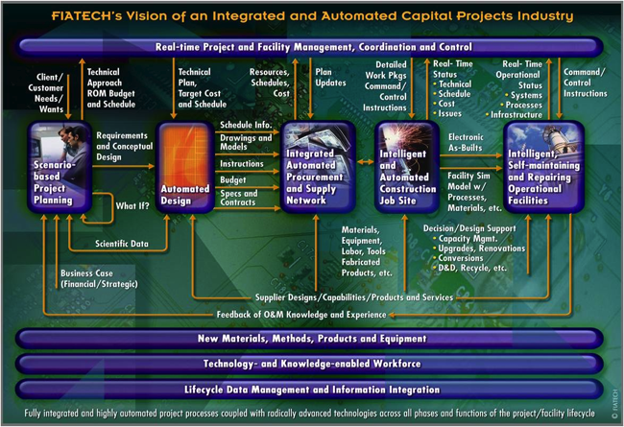
Holistic Approach to Realizing Productivity Improvement in the Capital Projects Industry
Scenario-based Project Planning
Automated Design
Integrated Automated & Procurement Supply Network
Intelligent & Automated Construction Job Site
Intelligent, Self-maintaining and Reporting Operational Facilities
Real-time Project & Facilities Management, Certification & Control
New Materials, Methods, Products & Equipment
Technology & Knowledge-enabled Workforce
Lifecycle Data Management & Information Integration
Notes:
Welcome to the Roadmap:
…..
FIATECH’s Capital Projects Technology Roadmap is a cooperative effort of associations, consortia, government agencies, and industry, working together to accelerate the deployment of emerging and innovative technologies intended to revolutionize the capabilities of the capital projects industry

Slide 6








Enabling Productivity Improvement
Collaborations
& Consensus Building
Industry Challenges
Optimal Deployable
Solutions
Subject Matter Expert Problem Solving Community
Notes:
Fiatech
It Approaches industry Challenges….. And collaborates with its members……. and Subject matter experts and is able to present deployable solutions through projects

Slide 7
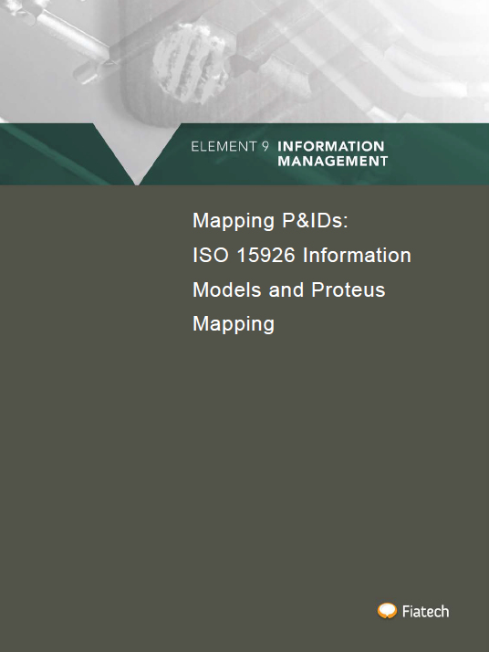
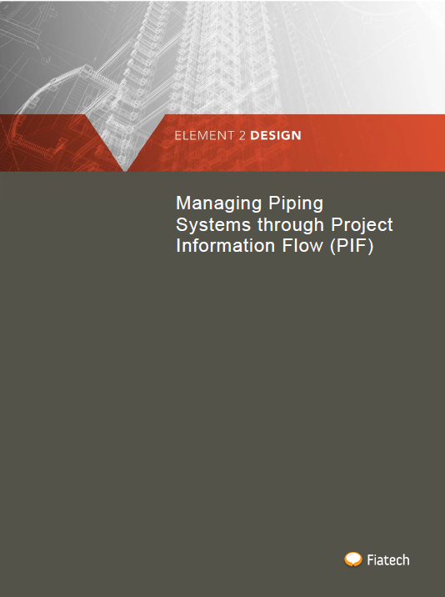
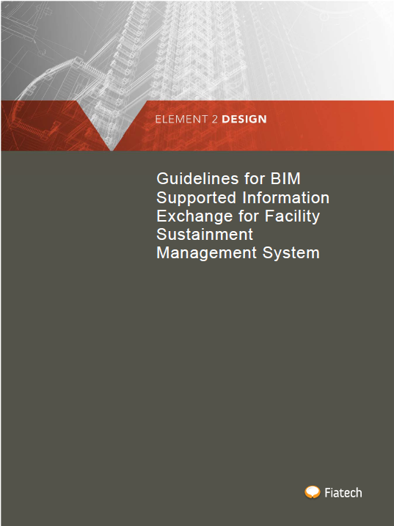

Recent & On-going Projects
Four recent reports
On-going
  MARS ROVER
  Integrated Materials Management
  Auto-Codes
  Integrated Models & Mapping (IIMM)
Productivity Advancement Targets
Notes:
Fiatech
It Approaches industry Challenges….. And collaborates with its members……. and Subject matter experts and is able to present deployable solutions through projects

Slide 8
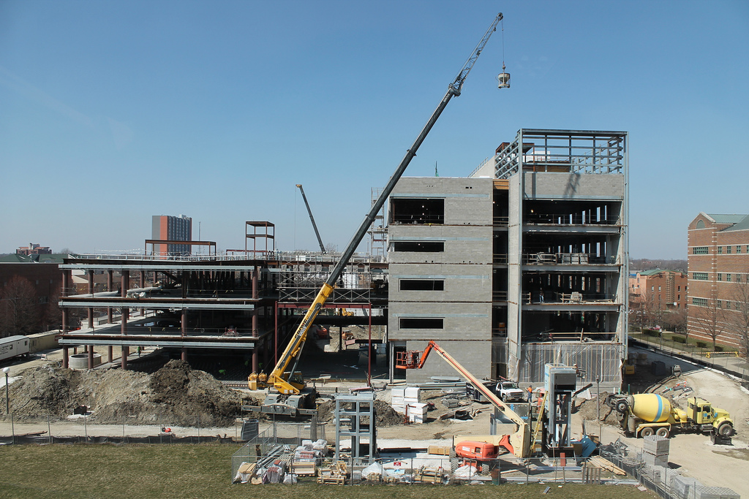

Project Managers
Rayan Jreije (CCC)
Mani Golparvar-Fard (University of Illinois)
Steering Committee Members
Todd Sutton (Zachry Construction)
Stuart Young (FIATECH)
MARS ROVER:
Image-based Localization via 3D Point Clouds
Notes:
….Image-based Localization via 3D Point Clouds for
Scalable “On-Demand” & “Mobile” Access to Project Information and schedule updates

Slide 9
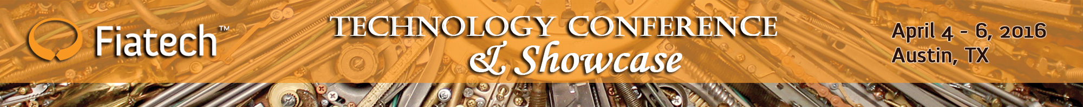
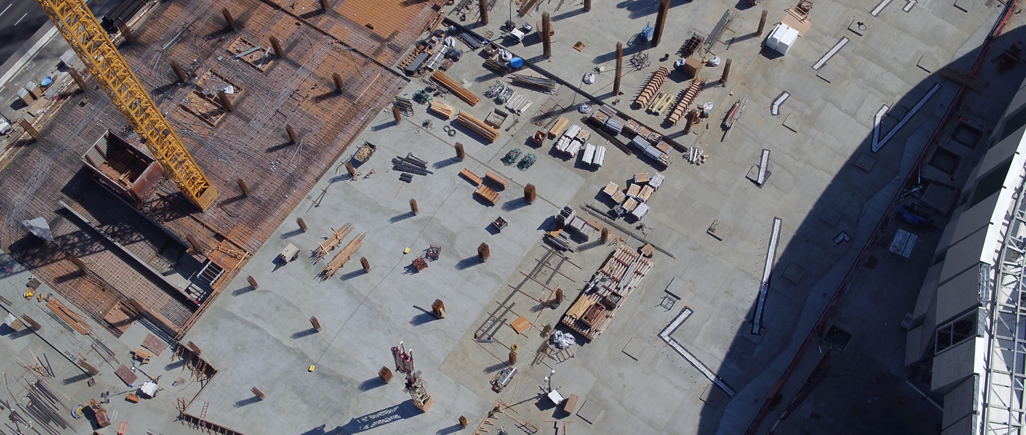
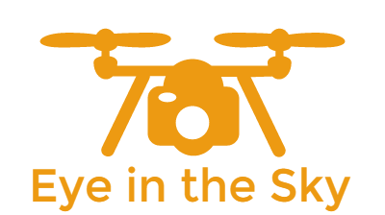
“Camera UAVs” for Monitoring Construction and Operation of Capital Projects
© $500M Sacramento King’s Stadium Project; University of Illinois, Reconstruct Inc., ImageInFlight, Turner Construction

Slide 10
ATOM EXPO 2017
Productivity Advancement Targets (PAT’s)
Notes:
What are PATs?...these don’t replace the Roadmap… merely supplements it:…
Organisations are constantly struggling to establish system-solution-oriented approaches to how work is defined and performed, in hopes of becoming more efficient and effective. The massive scale, complexity, short life cycle, and subtle stakeholder interdependencies have made realizing sustainable improvements extremely difficult. With that in mind, Fiatech subject matter experts (SMEs) have been rethinking why compelling improvements, with the potential for significant industry benefits, emerge with enthusiastic interest, only to rapidly fade away. To confront this tendency, members developed 12 Productivity Advancement Targets (PATs) and supporting success enablers, which currently exceed 300. Although PATs have been shared with the industry only on a limited basis, the response has been very strong. An aggregated breakdown of PAT touchpoint interest indicators are as follows: 135 Owner representatives; 225 EPC representatives; 215 solution provider representatives; 18 academic representatives; and 26 “other”.

Slide 11
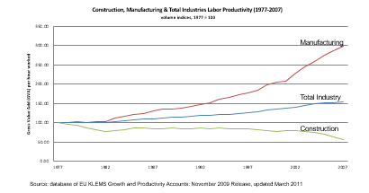
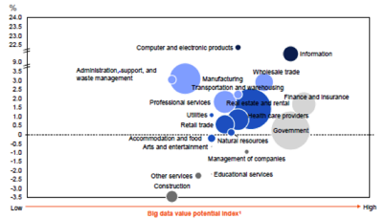
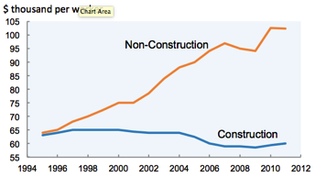
2. Overview of the Construction PAT - Advanced Work Packaging and Automated Field Control
The Capital Projects industry is surrounded by great talent, powerful technologies, and has best practices…
Why has our productivity not changed?
Why aren’t we getting great benefits?
Or, what is needed to harvest dramatic benefits?
* Barry B. LePatner, Esq., LePatner & Associates LLP
Notes:
Talking Points
Our industry is surrounded by great practices, great talent & powerful technologies…
Best practices, Standards, Training tools
Automation tools , 3D, 4D and now 5D modeling tools
Visualization tools, Analytics, Mobile IT, Robotics and Drones
RFID…etc so why has our productivity not changed?
Why aren’t we harvesting dramatic benefits?

Slide 12
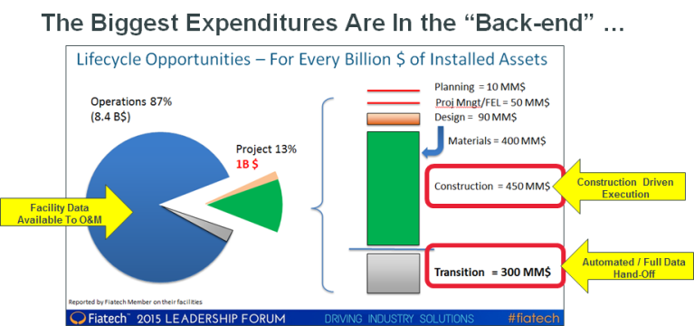
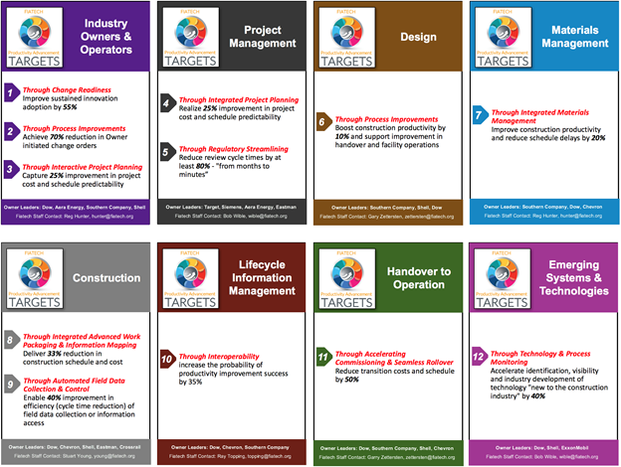
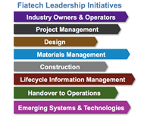
Integrated System Solutions and Technology Enabled Work Processes
Cost Model
Productivity Advancement Targets
Notes:
Fiatech’s members Believe the Fiatech Productivity Advancement Targets (PAT’s) if fully delivered, could save the industry…
$300 million (MM$) for every 1 billion dollars of investment plus 10% of Project Cycle Time.

Slide 13
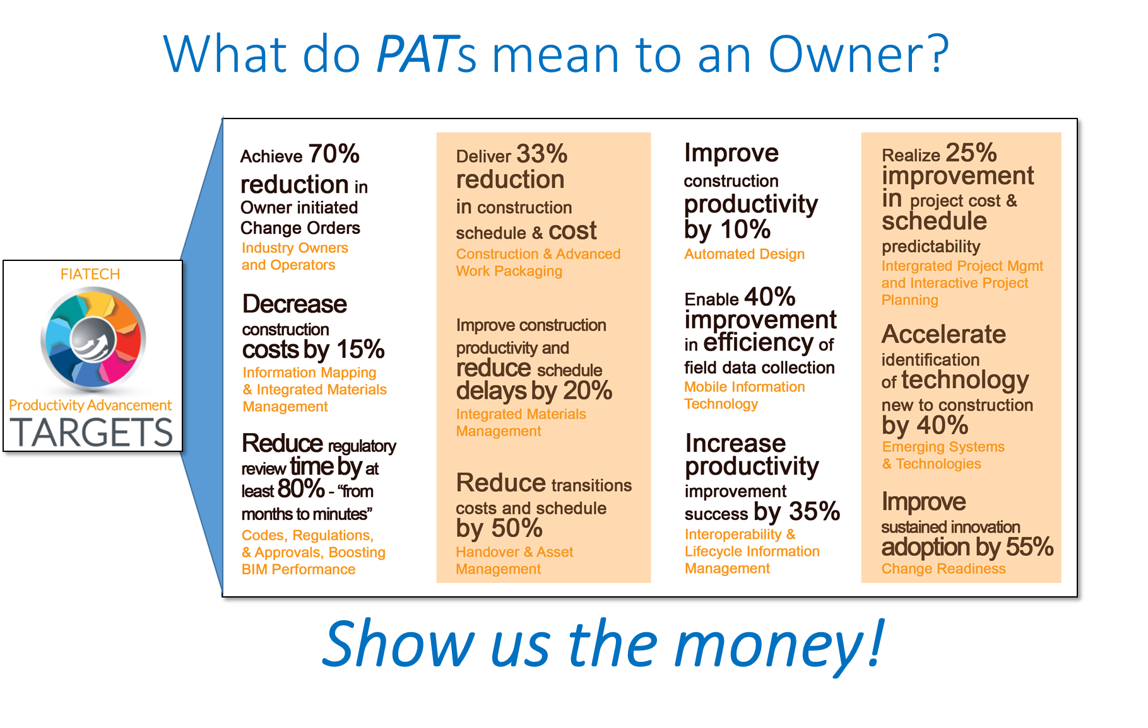

Slide 14



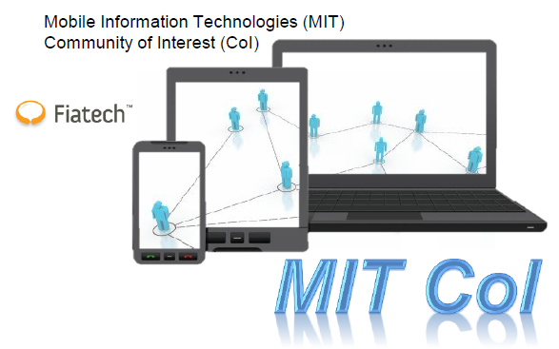
Coming Next…
Notes:
CII and Fiatech working together as one organization (2018)
Your R&D Center intent on delivering business results
Direct investment in technology research
Implementation in 5 industry sector committees
Critical Mass
Intellectual capital (more heads, more ideas, better outcomes)
143 members, moving toward 228
Full lifecycle perspective
True integration (fully formed

Slide 15

Notes:
Thank you for Joining us.

Slide 16
ATOM EXPO 2017
Best practices of digital adoption in industrial companies (session 1.2)
Notes:
Welcome: Ladies, Gents, Friends, Colleagues and Speakers to our session entitled: …Best practices of digital adoption in industrial companies
Main Topic of track: World economy is developing in completely different ways that a decade ago. Technology is the answer. Those who are not in the digital era are not on the train of world economy. The ambitious challenge is to become a digital corporation. In Recent Years Rosatom rapidly developed its Technological potential to ensure /enhance the competitive performance in international markets. Rosatom has a unique Multi D system of capital facilities for life cycle
Management , development and implementation of digital solutions. Taking into account the Russian Gov’t objectives on tech development Rosatom can become the driver for the country’s economic dev’t

