Slide 1
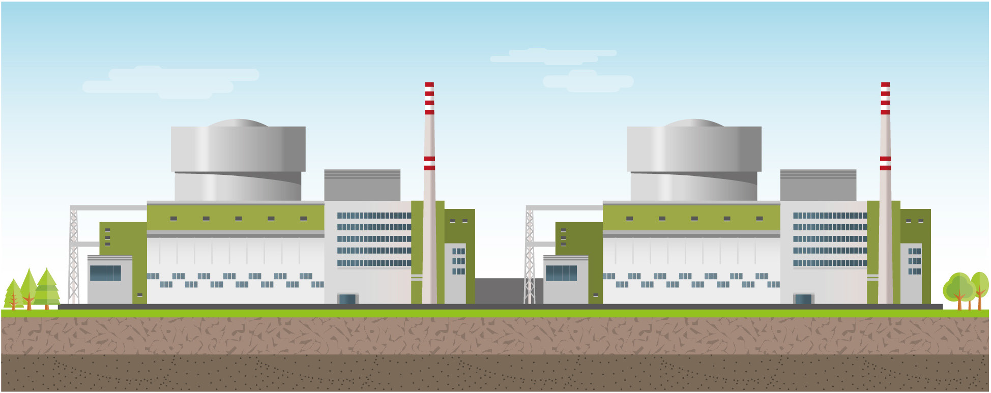
Back-end options for a small country with long term nuclear program
Prof. Dr. Attila Aszódi
State Secratariat for the maintenance of the capacity of the Paks NPP
Atomexpo
Moscow, 19/06/2017

Slide 2
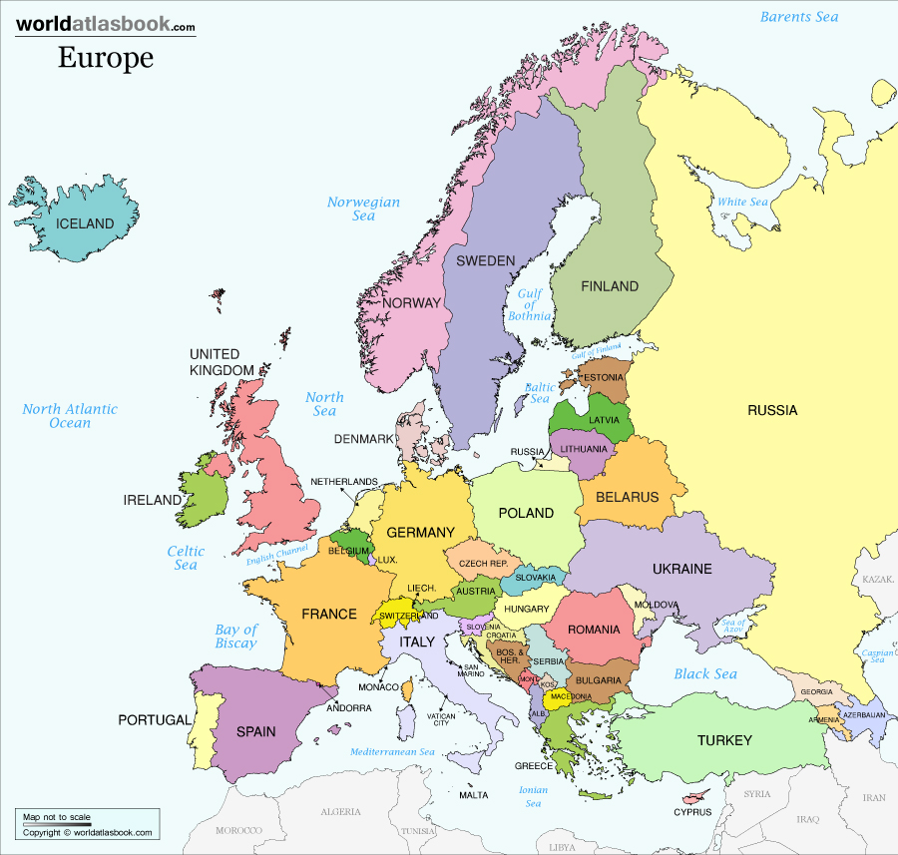
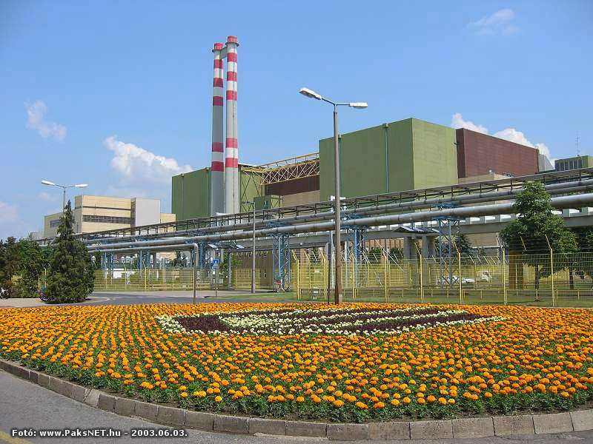
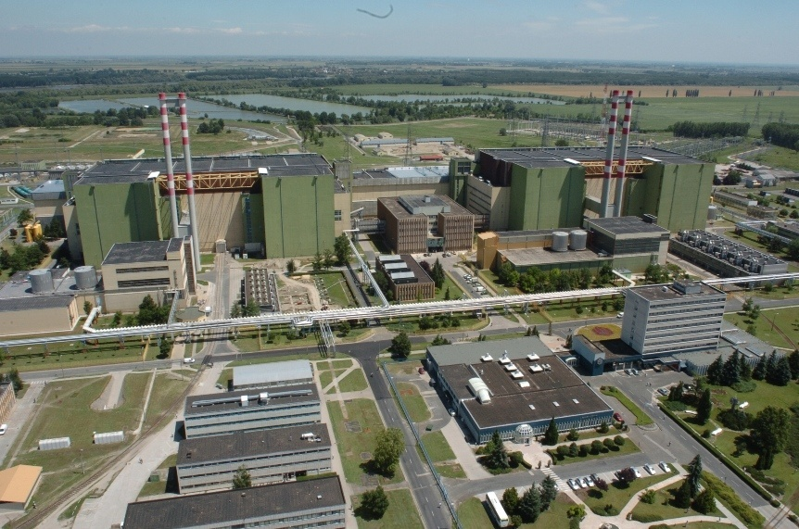
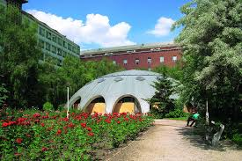
Hungary
Paks NPP
4*500 MW
Budapest Research Reactor
1987 2037
1986 2036
1984 2034
1982 2032
Budapest Training Reactor
Nuclear share in electricity production 51%
Nuclear share in electricity consumption 36%

Slide 3
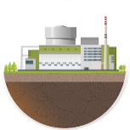
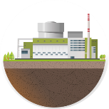
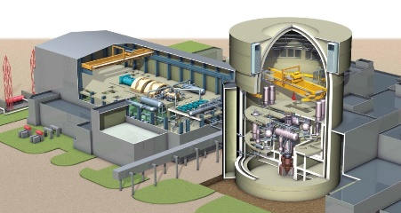
Status of the Paks II. project
Environmental licensing process
Site licensing process
Approvals of the European Union
The construction licensing and the implementation of the project can be started

Slide 4
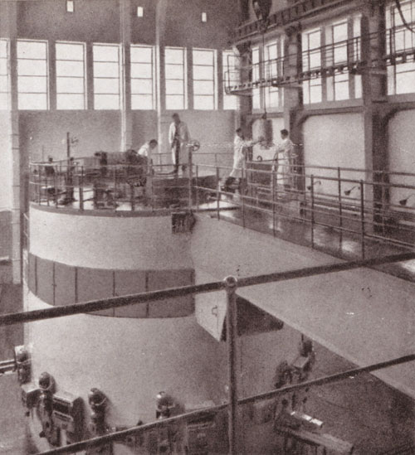
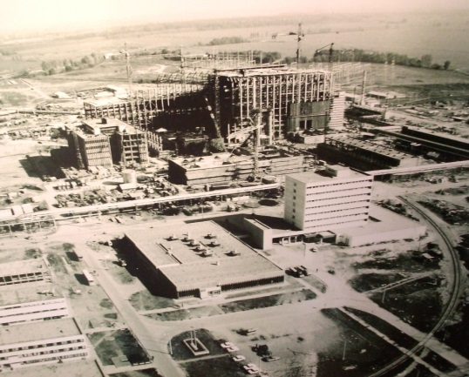
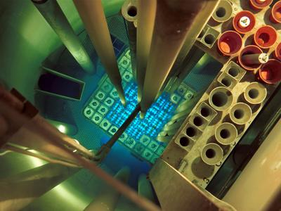
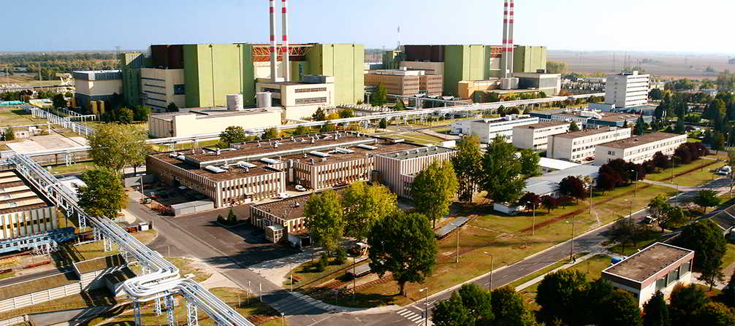
Long term nuclear program in Hungary - Past
The first nuclear reactor reaches criticality in the territory in Hungary (today: Budapest Research Reactor)
1959
1967
Start of the construction of the Paks NPP
The Training Reactor of the Budapest University of Technology comes into operation
1971
1982-87
The 1-4 units of the Paks NPP start their operation
Source of pictures: egykor.hu, reak.bme.hu, wikipedia.hu, atomeromu.hu

Slide 5
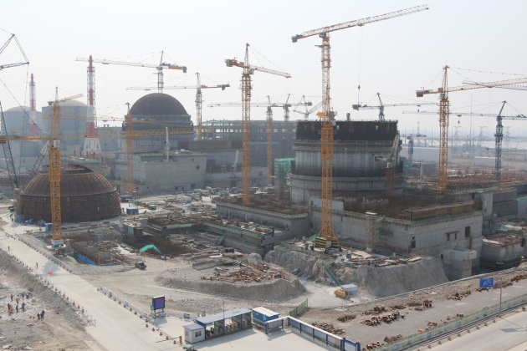
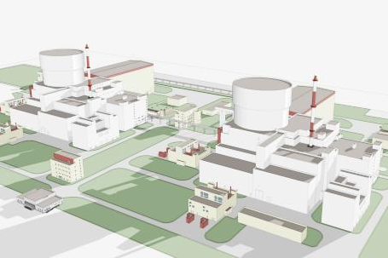
Long term nuclear program in Hungary – Present & Future
2012-17
Lifetime extension of Paks NPP for 20 years
Preparation, construction and commissioning of Paks II (units 5-6)
Construction of the Tianwan NPP in 2015
2014-26
2032-37
End of the extended lifetime of the Paks NPP
2085-86
End of the lifetime of the Paks II. NPP
Source of picture: atomeromu.hu,

Slide 6
National Policies of the EU Member States
2011/70/EURATOM Directive provides for responsible and safe management of spent fuel and radioactive waste:
(20): „ Each Member State remains free to define its fuel cycle policy. […]”
(28): „Member States should establish national programmes to ensure […] the timely implementation of all steps of spent fuel and radioactive waste management from generation to disposal.”
Most of the EU Member States submitted their national programme by the deadline, with some exception.
3 Member States are planning to bring their final disposal into operation in the 2020s: Finland, Sweden and France.
In Germany a committee examines the possibility to build a HLW repository, its proposal related to the site will be submitted to the government until 2031.
Other Member States chose the do-and-see policy:
Long term interim storage is possible
Spent Nuclear Fuel is NOT waste
Some countries reprocess their SNF, in this case the final disposal of the vitrified waste has to be done. (different waste-matrix and smaller quantity)

Slide 7
National Policy of Hungary for SNF management
Proposed by the Public Limited Company for Radioactive Waste Management (PURAM)
Based on the Article 5/B of the Act of CXVI 1996 on Atomic Energy
Elaborated by the Ministry of National Development
Adopted by the Parliament (28.04.2015)
Entered into force (5.05.2015)
Revision in every 5 years
Scope:
General principles of responsibilities and obligations
Description of use of radioactive materials and nuclear energy in Hungary
Regulations, infrastructural framework and radioactive waste classification scheme
Parameters of the National Program
Need for a final disposal facility
Involvement of the public

Slide 8
National program – management of SNF
Possible scenarios according to the National Program:
A: Direct disposal of the spent fuel – reference scenario
B: reprocessing of the SNF with or without interim storage
C: advanced reprocessing of SNF (separation of minor actinides) – not real possibility at the moment because this service is not available on the market
Use of reprocessed fuel: MOX/REMIX fuel is theoretically possible for VVER-1200 units!

Slide 9
National program – management of SNF
Decision points defined in the National Program
Interim Storage of SNF
Reprocessing
Usage of reprocessed fuel
Interim storage of the waste generated during reprocessing
Final disposal in Hungary in deep geological repository
NO
Paks NPP
NO
HU
Y
Abroad
Y
HU
Abroad
Y
HU
Abroad
HU
Y
NO
HU
Paks II NPP
NO
Abroad
NO
NO
HU
RU
Y
Abroad
Y
HU
Abroad

Slide 10
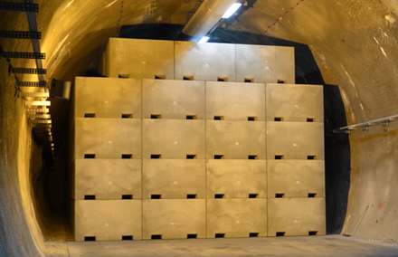
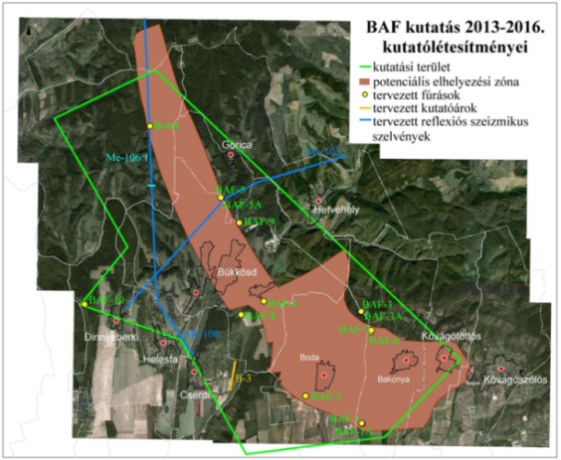
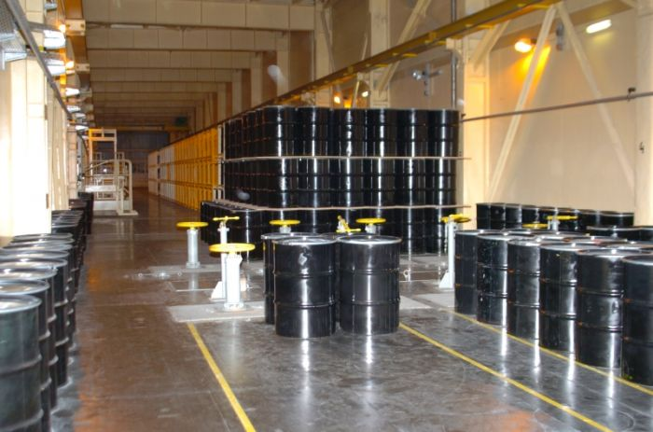
Final disposal of radioactive waste
Radioactive waste management is a task of the state, waste management costs are to be paid by the operator.
Low- and intermediate-level waste
Interim storage possibility on the site
Final disposal: National Radioactive waste storage (NRHT), Bátaapáti, HU
near-surface facility, in depth of 250 m
High level waste/Spent fuel
Investigations near Boda, as the most promising site
Boda Calystone Formation, in the depth of 500-1000 m
Goal: to mark out the exact location of the deep geological location until 2030
Actual plan to start the operation: 2064
Boda site map
NRHT techological building
NRHT vault
Ground profile at Boda
Existing facility (1st vault in 2012)
In research phase

